Slide 1
Master Presentation

Slide 2
Michael Quach

Slide 3

Venus Exploration Propulsion System Design
Michael Quach
ARO 481lL-01
October 9th, 2023

Slide 4
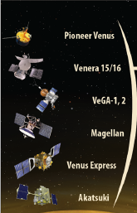
Introduction
Venus Orbiter Requirements
Mission ConOps
Orbiter Propulsion
Orbiter Mass Statement
Conclusion
Reference Slides
Courtesy:
Planetary Science Journal

Slide 5
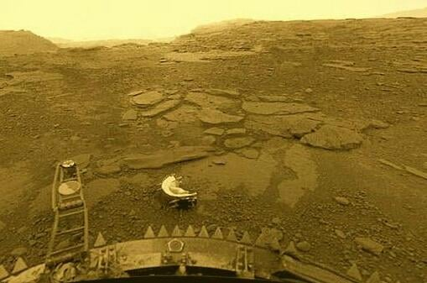
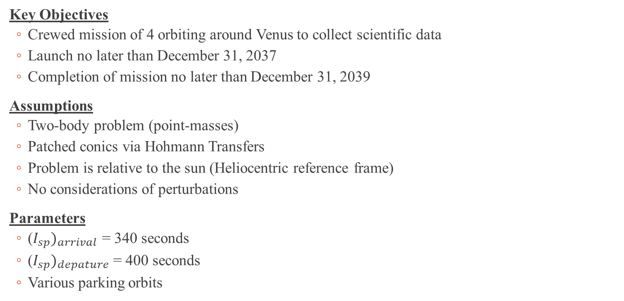
Mission Overview
Key Objectives
Crewed mission of 4 orbiting around Venus to collect scientific data
Launch no later than December 31, 2037
Completion of mission no later than December 31, 2039
Assumptions
Two-body problem (point-masses)
Patched conics via Hohmann Transfers
Problem is relative to the sun (Heliocentric reference frame)
No considerations of perturbations
Parameters
($I_{sp})_{arrival}$ = 340 seconds
($I_{sp})_{depature}$ = 400 seconds
Various parking orbits
Courtesy:
Planetary Science Journal

Slide 6
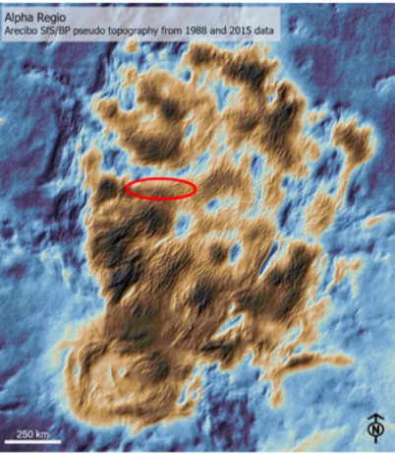
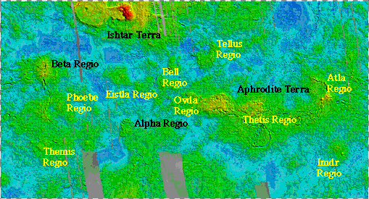
Landing Site and Scientific Goals
Landing Sites
Alpha Regio: Largest highland regions on Venus near the Equator
Beta Regio: Prominent highland with coronae structures
Ishtar Terra: Highland region near the Northern Hemisphere – Maxwell Montes
Aphrodite Terra: Highland region near the Southern Hemisphere
Scientific Goals
Composition and structure of planet’s crust and mantle
Analyzing the minerals and surface composition
Analyzing and capturing the composition of the Venusian atmosphere
Courtesy:
DAVINCI

Slide 7
System Level Requirements
Category | Description | Validation Method
T.0.0-1 | The orbiter must have the capacity for 4 crew members | Crew testing
T.0.0-2 | The orbiter shall have the ability to be controlled by the crew and collect samples | Hardware-in-the-loop
T.0.0-3 | The vehicle shall be parked in orbit such that it provides a desirable LOS and reliable data rate | In-flight mission
C.0.0-1 | Cost shall not exceed $1 Billion US dollars mission wide | System completion
M.0.0-1 | The mission shall be completed no later than December 31, 2039 lasting no longer than 30 Earth days | Mission completion
M.0.0-2 | Launch for the mission shall be no later than December 31, 2037 | Actual launch date

Slide 8
Derived Requirements (1/2)
Category | SLR Reference | Description | Validation Method
T.1.1-1 | T.0.0-1 | The team shall make use of past NASA designs and utilize the average astronaut size to fit the whole crew with a extra space margin of ± 10% volume. | Crew testing
T.1.2-1 | T.0.0-2 | The team shall conduct latency tests with the orbiter on Earth mimicking the relay between the orbiter and crew spacecraft to verify a latency of < 0.1ms with a ±0.1%. | Hardware-in-the-loop testing
T.1.2-2 | T.0.0-2 | The orbiter shall have the capability of analyzing the Venusian atmosphere utilizing a suite of instruments. | Operation during mission
T.1.2-2.1 | T.1.2-2 | The laser spectrometer shall capture the key thermodynamic and surface composition properties within a ±.01% margin | Hardware-in-the-loop testing

Slide 9
Derived Requirements (2/2)
Category | SLR Reference | Description | Validation Method
C.1.1-1 | C.0.0-1 | The team shall have regular meetings with the vendors to ensure that all projects are on-track. | Budget tracking
M.1.1-1 | M.0.0-1 | Trajectory team shall communicate with the logistics team to ensure the launch vehicle leaves within the optimal launch window. | Crew testing
M.1.2-1 | M.0.0-2 | Ground station shall keep in communication with the crew to ensure everything is operational within the module | Mission in operation

Slide 10
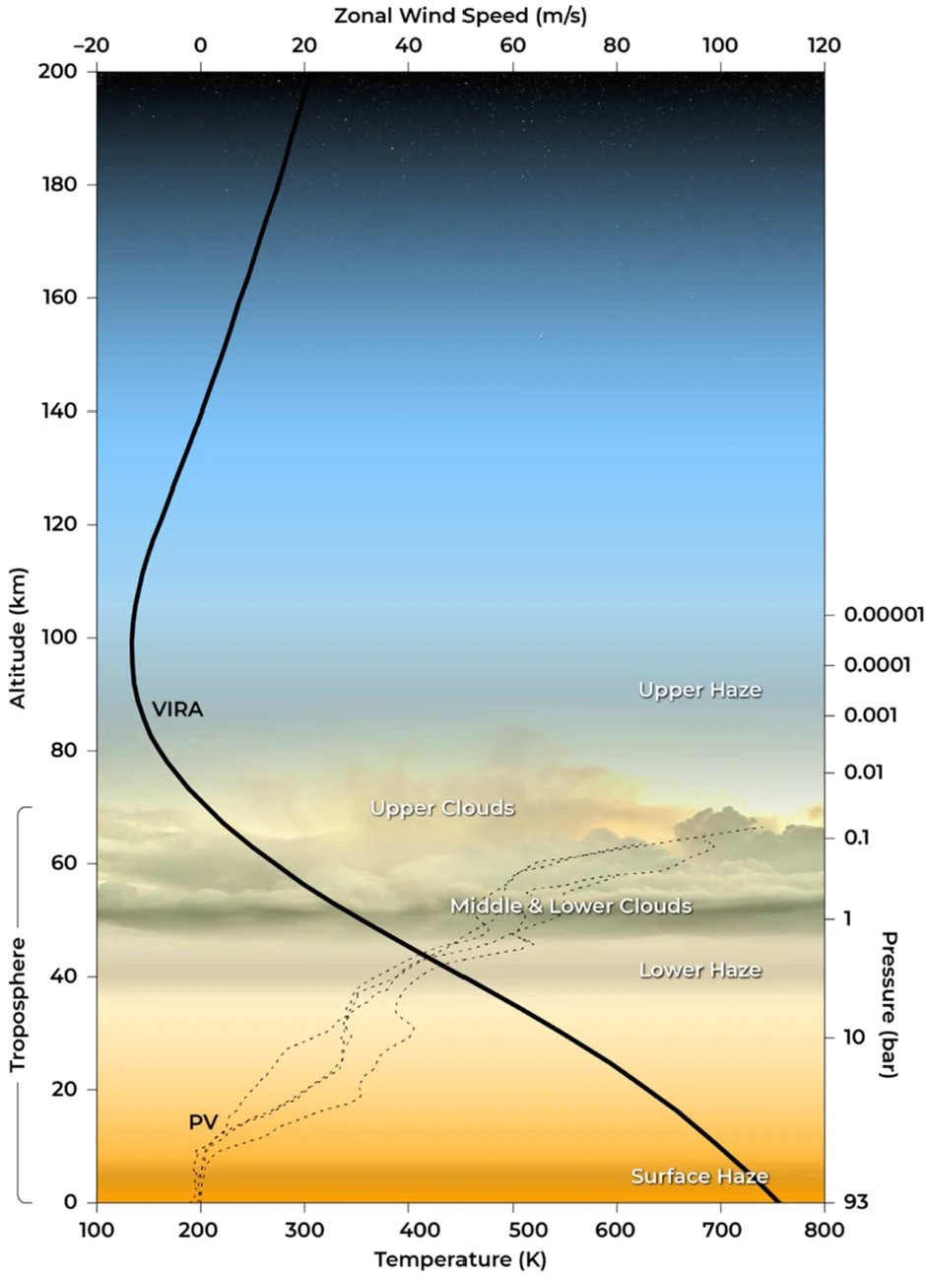
Expected Venusian Atmospheric Properties
Altitude range (50-55 km)
Density: 66.07 - 70 kg/m^3
Temperature: 300-400 K
Pressure: ~1-2 atm
Zonal Wind Speed: 45-55 m/s
Courtesy: VIRA

Slide 11
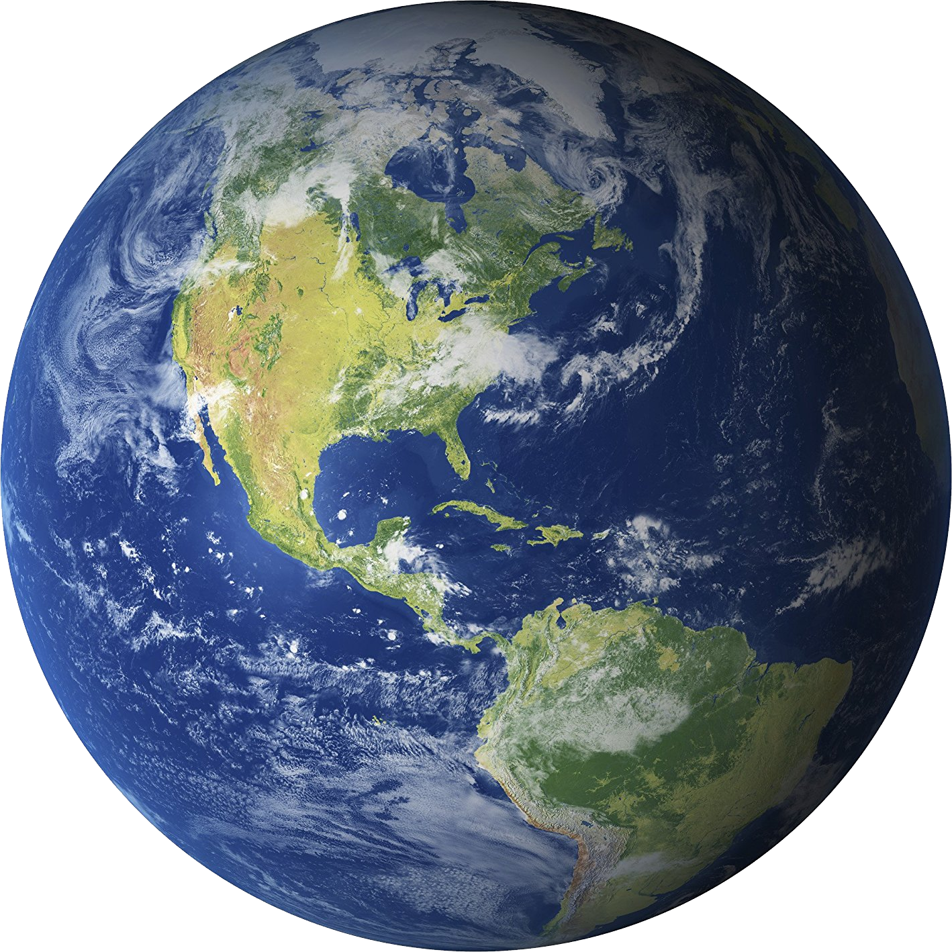

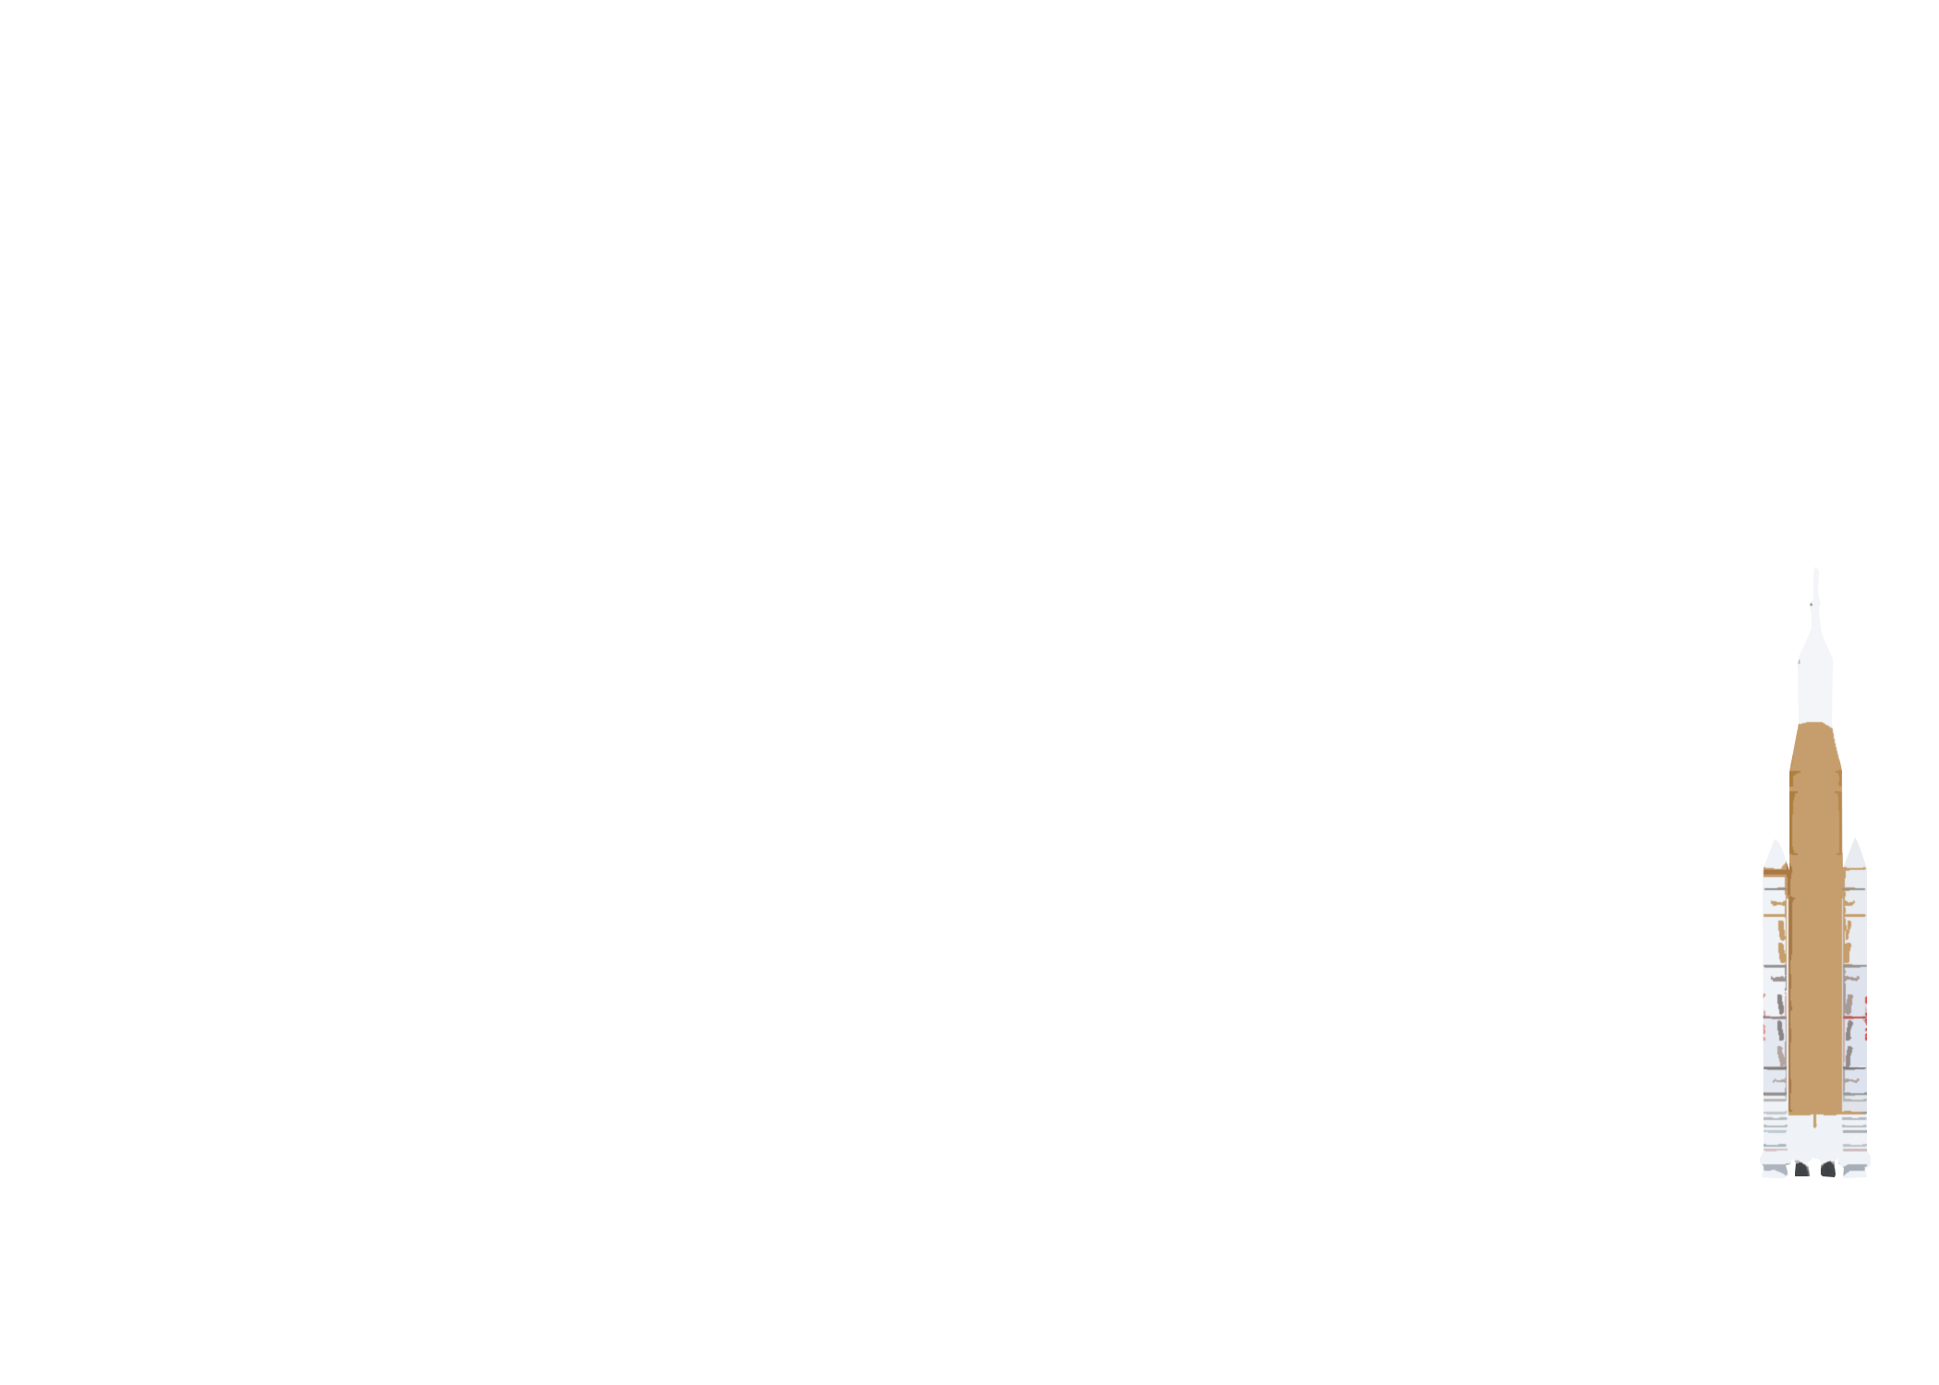

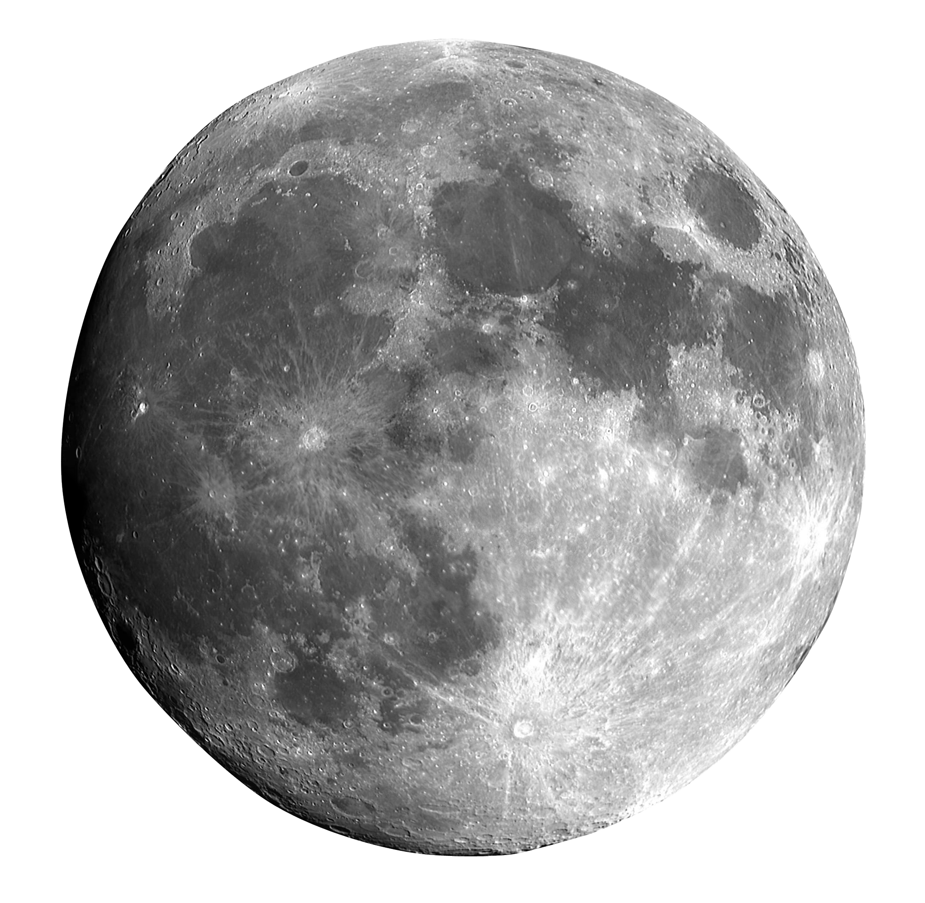
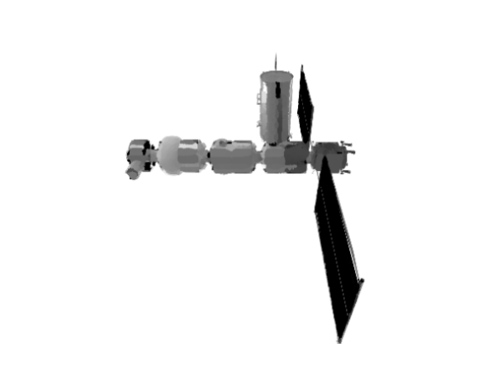
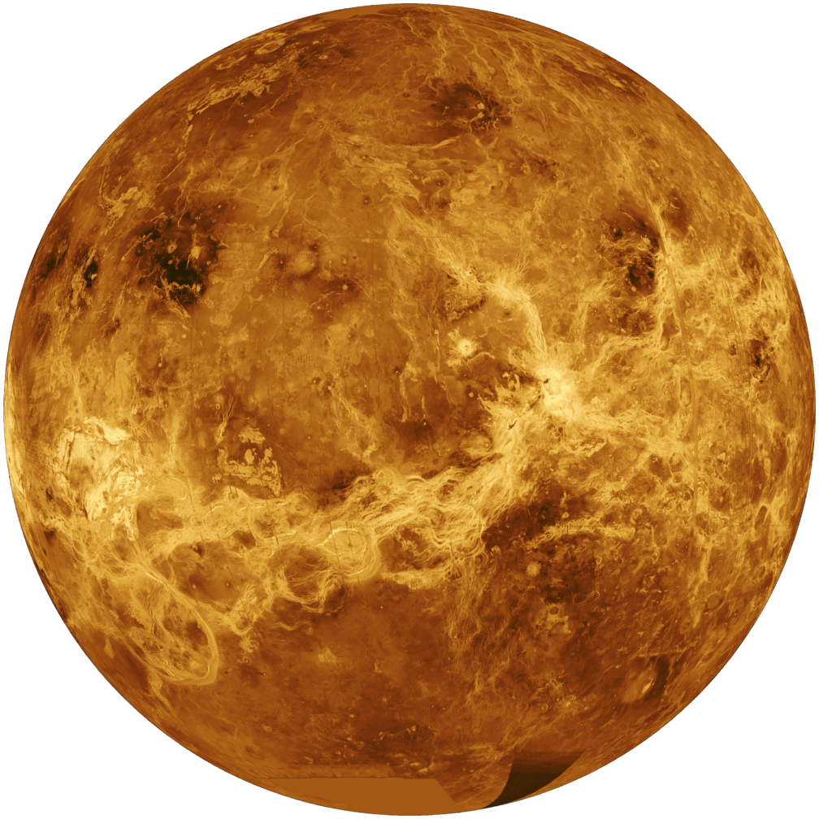
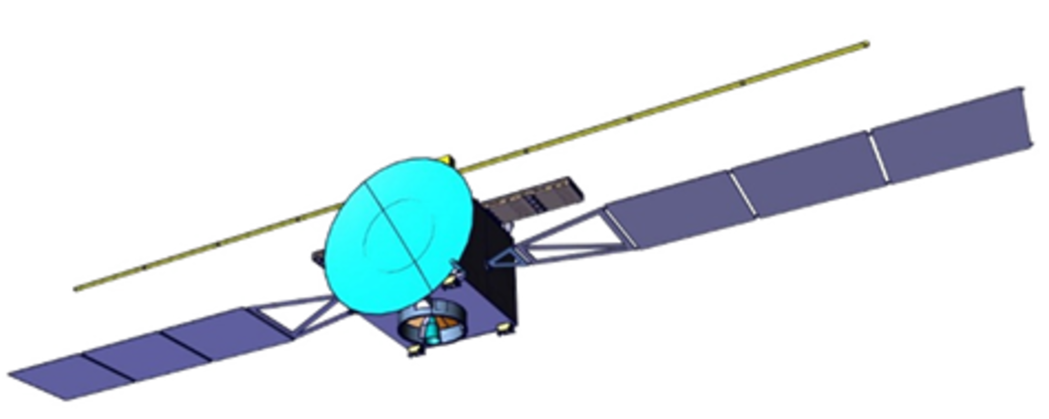
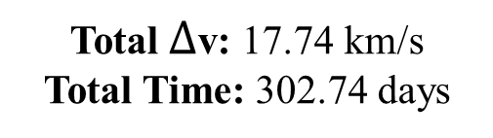
ConOps Diagram (Crew Module)
(1) SLS enters parking orbit
Total $∆$v: 17.74 km/s
Total Time: 302.74 days
(2) Crew module detaches from SLS
(9) Crew module reenters into Earth
(8) Crew module attaches and leaves from Gateway
(7) Crew module leaves Venus
(3) Crew module docks onto Gateway
(4) Crew module leaves Gateway to Venus
(6) Crew module establishes COMMs with the orbiter
Mission conducted
(5) Venus Orbit insertion

Slide 12
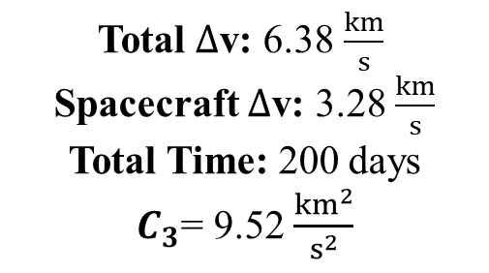
ConOps Diagram (Spacecraft)
(1) Upper stage and orbiter
Total $∆$v: 6.38 $\frac{km}{s}$
Spacecraft $∆$v: 3.28 $\frac{km}{s}$
Total Time: 200 days
$C_{3}$= 9.52 $\frac{{km}^{2}}{s^{2}}$
(2) Trans-Venus injection burn
(3) Spacecraft detaches from upper stage
(4) Mid-course correction
(6) Spacecraft enters Venusian atmosphere
(5) Venus Orbit insertion

Slide 13
Mission In-depth (1/2)
(6) Crew module establishes COMMs with the orbiter
Mission conducted
(6.3) Planned docking between the orbiter and crew to transfer over captured atmospheric capsules
(6.1) The orbiter will capture atmospheric data at various altitudes and deploy probes when commanded by the crew
(6.4) The orbiter will maintain its orbit until the mission duration and then descend into Venus’s orbit
(6.2) The orbiter will relay the data from itself and the probes back to the team

Slide 14
Mission In-depth (2/2)
(6.1)
Entry into Venus
(6.2)
Back shell detaches
(6.3)
Deploys pilot chute
(6.4)
Extract chute bag
(6.5)
Deploys main chute
(6.6)
Aeroshell separation
Average rate of descent: 0.1111 m/s
(6.7)
Probe enters free-fall

Slide 15
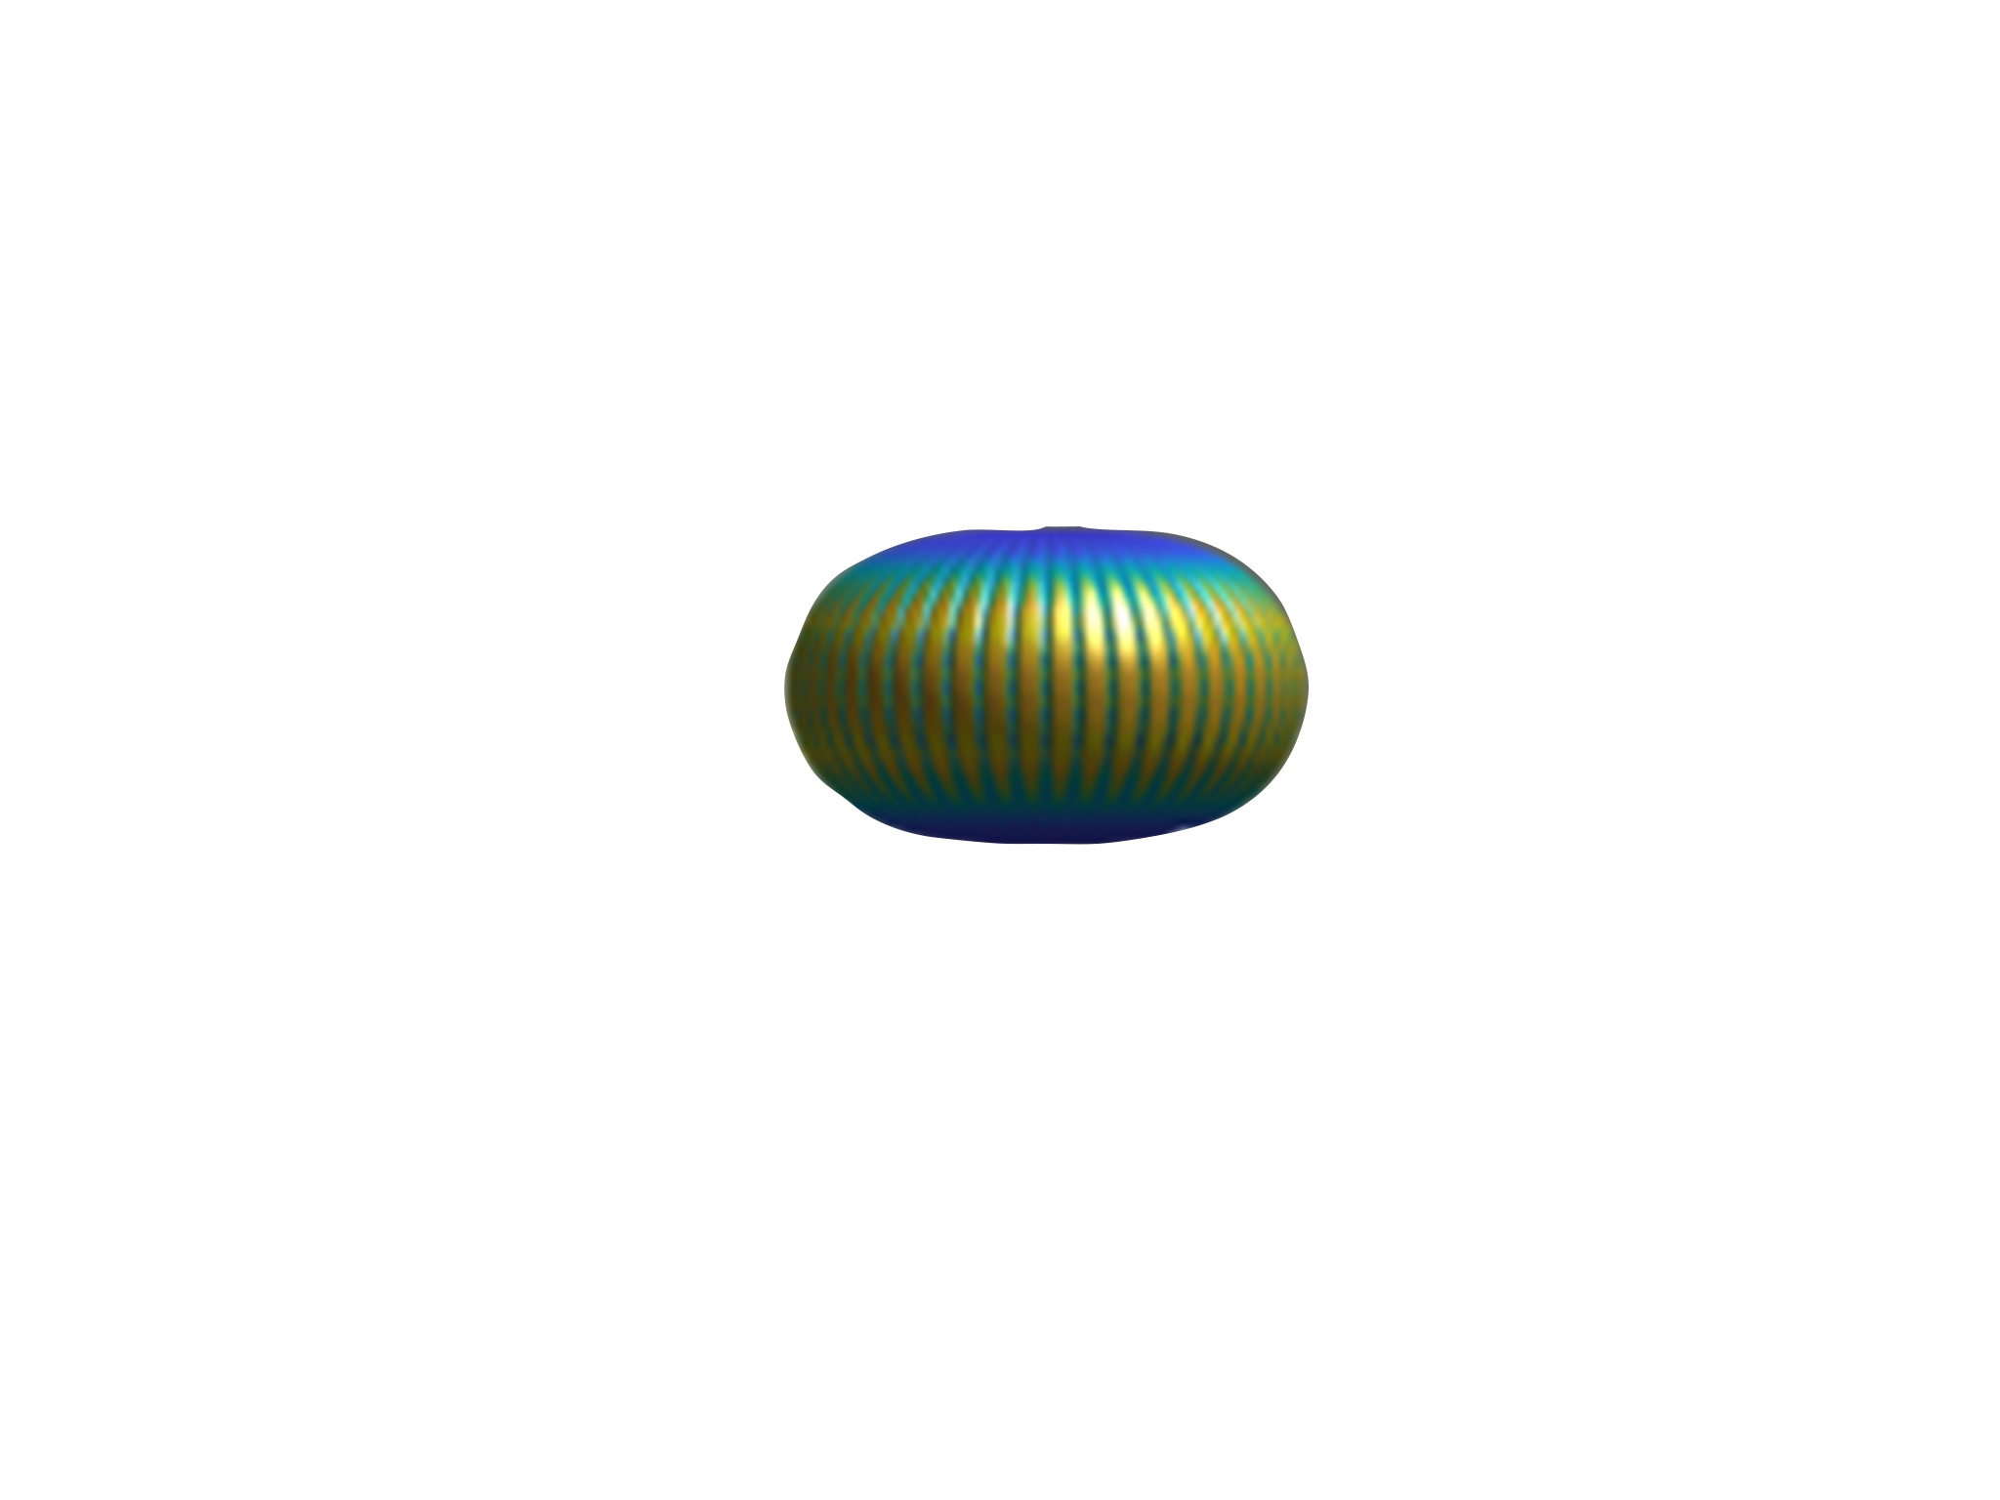

Mission Operations
Circumnavigation 1
Circumnavigation n
60
D
A
55
Altitude (km)
E
F
G
B
C
50
45
H
0
0
120
240
Time (Earth Hours)

Slide 16
Mission Operations Step-by-step (Balloon)
A.) After detaching from the aeroshell, the balloon will inflate
B.) The team will initialize the payload to begin collecting data
C.) The rest of the critical science instruments will be switched on by the crew
D.) The team will depressurize the balloon to lower the altitude via valve system
E.) The team will repressurized the balloon to keep it within the “goldilocks zone”
F.) The balloon will continue to depressurize the balloon when it reaches its max height
G.) The team will continue to repressurize the balloon when it reaches its lowest height
H.) Crew navigates the balloon to land on Alpha Regio

Slide 17
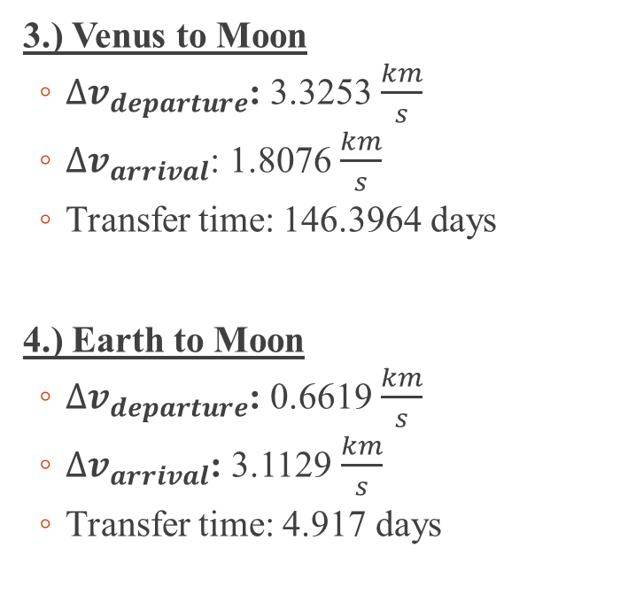
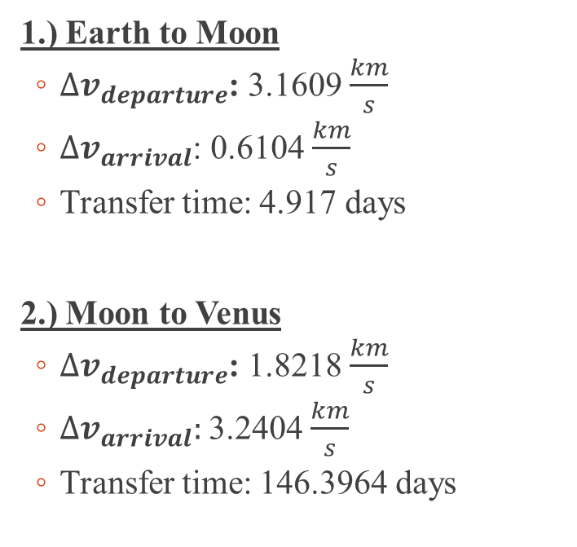
Orbital Maneuvers Summary (Crew Module)
1.) Earth to Moon
${∆v}_{departure}$: 3.1609 $\frac{km}{s}$
${∆v}_{arrival}$: 0.6104 $\frac{km}{s}$
Transfer time: 4.917 days
2.) Moon to Venus
${∆v}_{departure}$: 1.8218 $\frac{km}{s}$
${∆v}_{arrival}:$3.2404 $\frac{km}{s}$
Transfer time: 146.3964 days
3.) Venus to Moon
${∆v}_{departure}$: 3.3253 $\frac{km}{s}$
${∆v}_{arrival}$: 1.8076 $\frac{km}{s}$
Transfer time: 146.3964 days
4.) Earth to Moon
${∆v}_{departure}$: 0.6619 $\frac{km}{s}$
${∆v}_{arrival}$: 3.1129 $\frac{km}{s}$
Transfer time: 4.917 days

Slide 18
Orbital Maneuvers Summary (Orbiter)
1.) Earth to Moon
${∆v}_{departure}$: 3.1609 $\frac{km}{s}$
${∆v}_{arrival}$: 0.6104 $\frac{km}{s}$
Transfer time: 4.917 days
2.) Moon to Venus
${∆v}_{departure}$: 1.8218 $\frac{km}{s}$
${∆v}_{arrival}:$3.2404 $\frac{km}{s}$
Transfer time: 146.3964 days

Slide 19
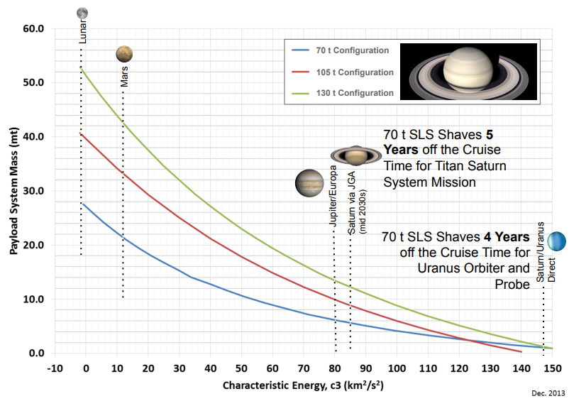
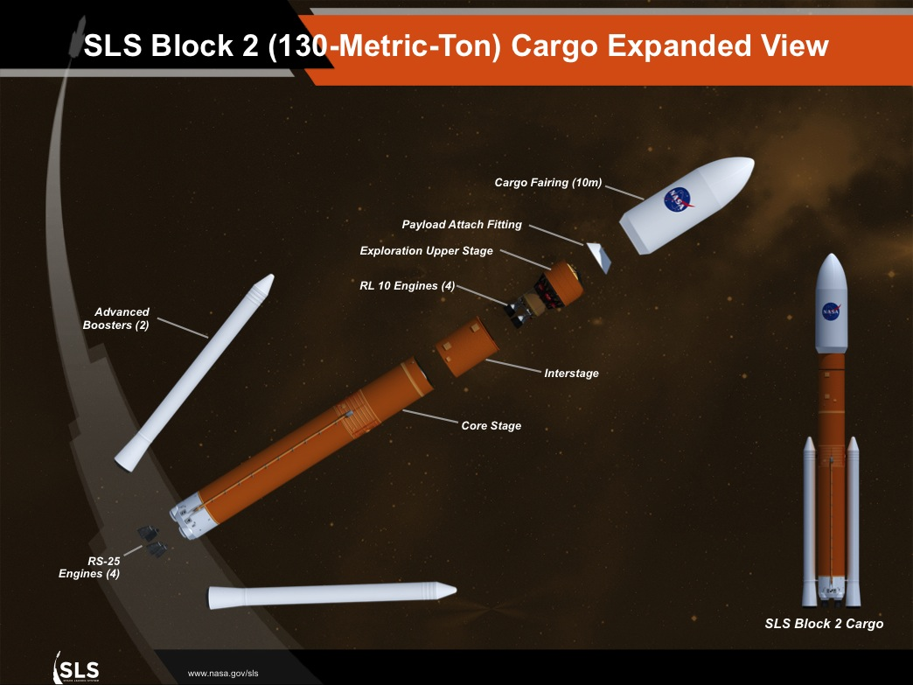
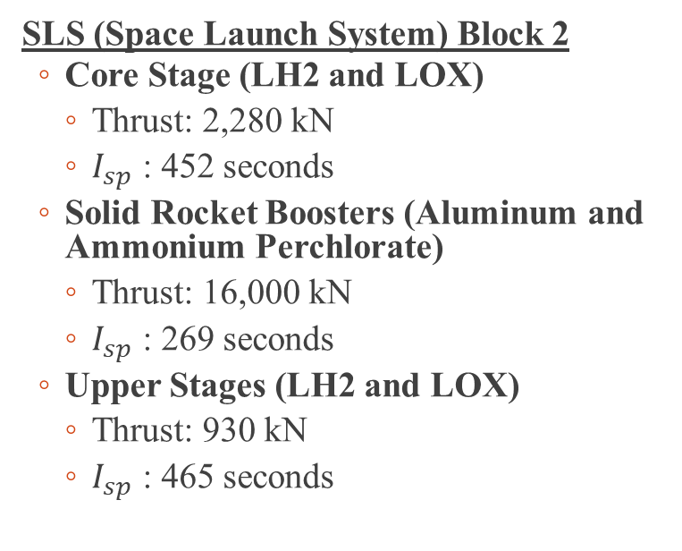
Launch Vehicle
SLS (Space Launch System) Block 2
Core Stage (LH2 and LOX)
Thrust: 2,280 kN
$I_{sp}$ : 452 seconds
Solid Rocket Boosters (Aluminum and Ammonium Perchlorate)
Thrust: 16,000 kN
$I_{sp}$ : 269 seconds
Upper Stages (LH2 and LOX)
Thrust: 930 kN
$I_{sp}$ : 465 seconds
Courtesy: NASA

Slide 20
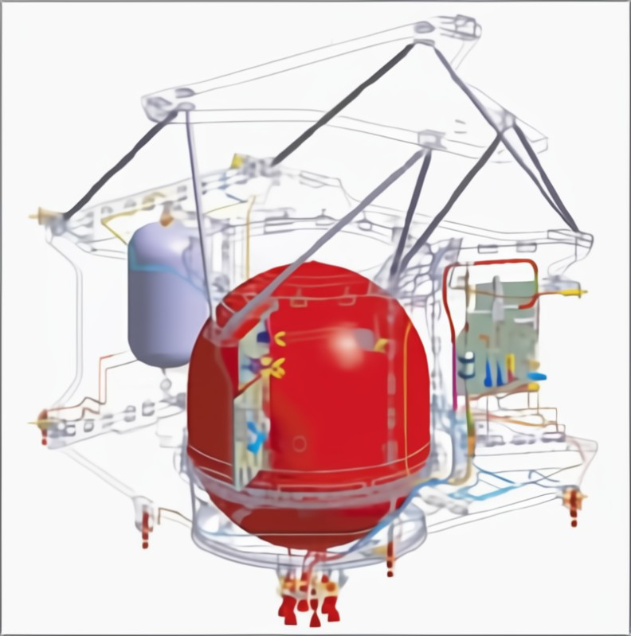
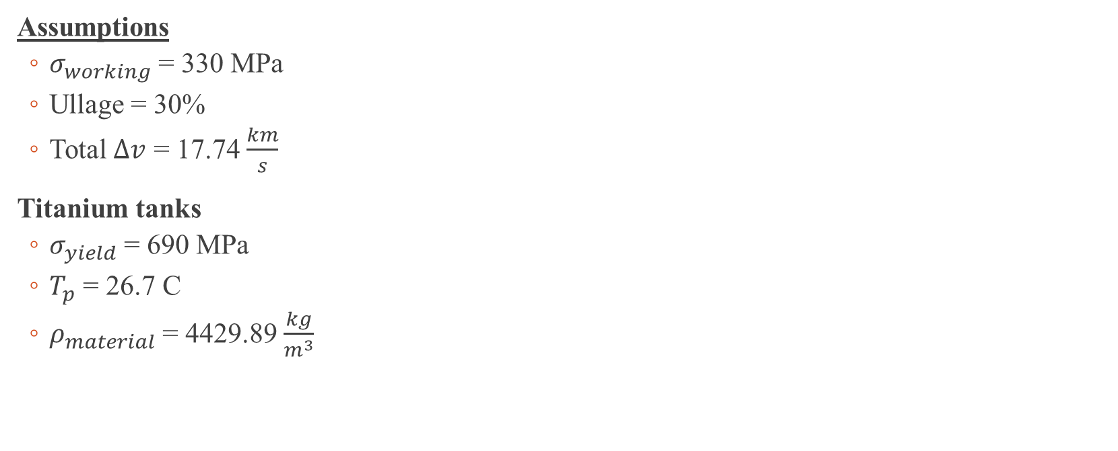
Propulsion System Analysis Assumptions
Assumptions
$σ_{working}$ = 330 MPa
Ullage = 30%
Total $∆v$ = 17.74 $\frac{km}{s}$
Titanium tanks
$σ_{yield}$ = 690 MPa
$T_{p}$ = 26.7 C
$ρ_{material}$ = 4429.89 $\frac{kg}{m^{3}}$
Courtesy:
NASA

Slide 21
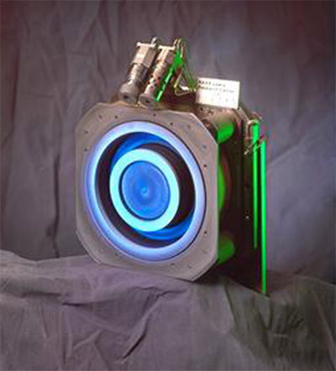
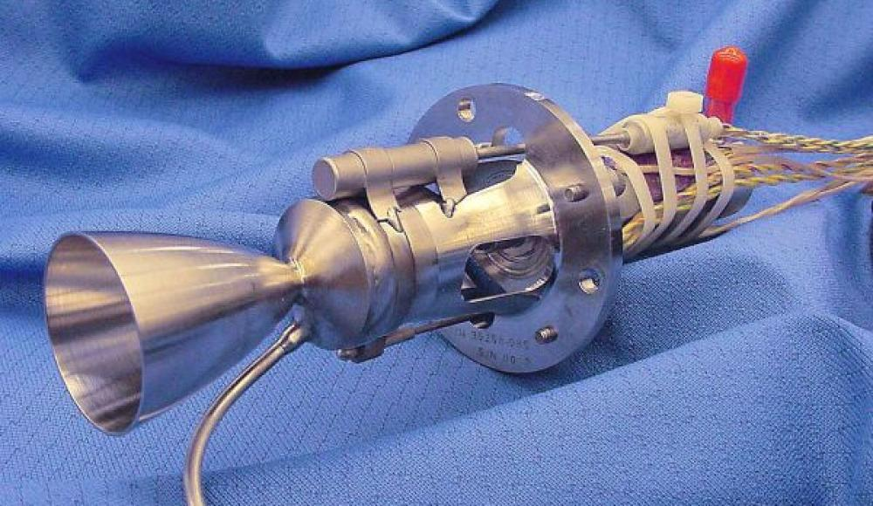
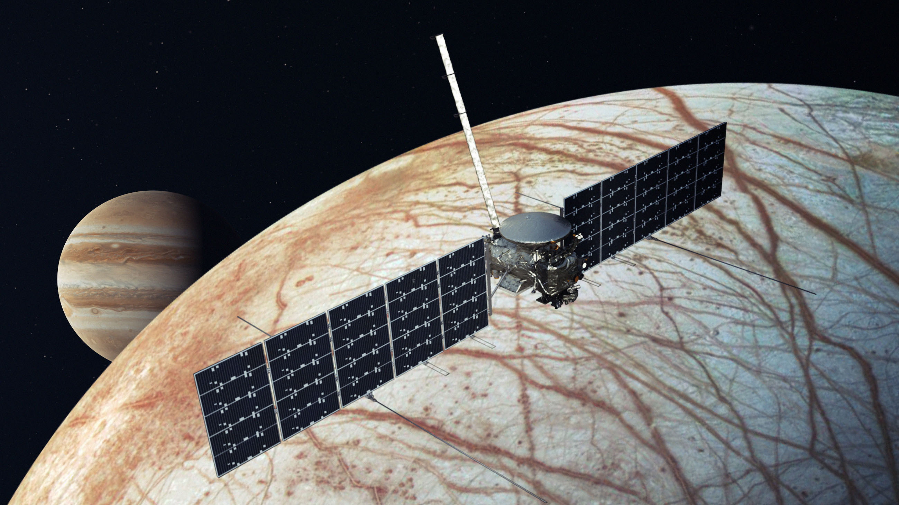
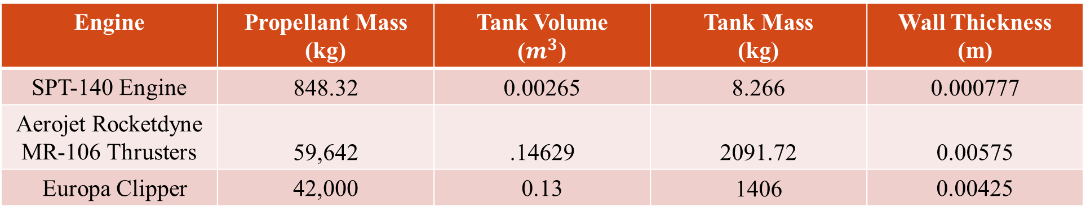
Orbiter Propulsion System Trade Study
Engine | Propellant Mass (kg) | Tank Volume ($m^{3}$) | Tank Mass (kg) | Wall Thickness (m)
SPT-140 Engine | 848.32 | 0.00265 | 8.266 | 0.000777
Aerojet Rocketdyne MR-106 Thrusters | 59,642 | .14629 | 2091.72 | 0.00575
Europa Clipper | 42,000 | 0.13 | 1406 | 0.00425
Courtesy:
NASA

Slide 22
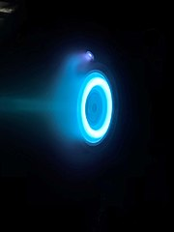
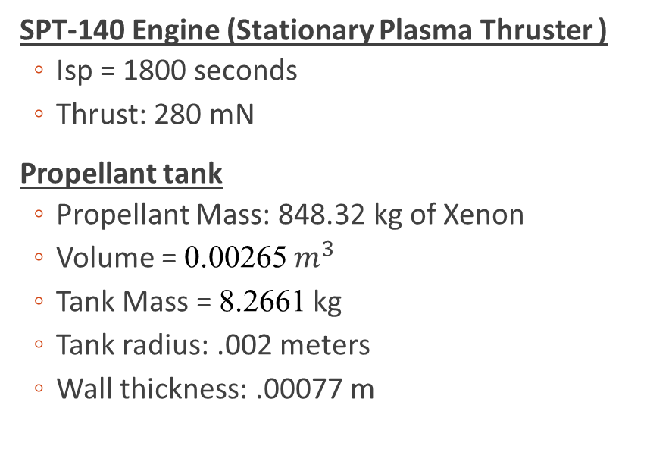
Orbiter Propulsion System
SPT-140 Engine (Stationary Plasma Thruster )
Isp = 1800 seconds
Thrust: 280 mN
Propellant tank
Propellant Mass: 848.32 kg of Xenon
Volume = 0.00265 $m^{3}$
Tank Mass = 8.2661 kg
Tank radius: .002 meters
Wall thickness: .00077 m
Courtesy: NASA

Slide 23
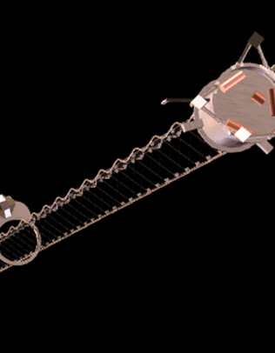
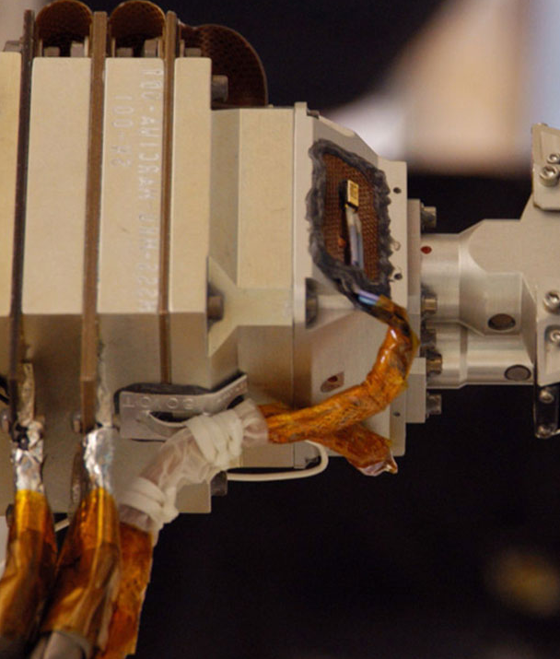
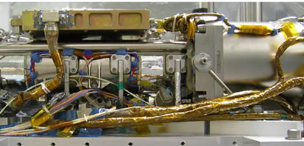
Orbiter and Probe Instruments (1/2)
Tunable Laser Spectrometer (TLS)
Analyze the composition of the Venusian atmosphere
Europa Clipper Magnetometer (ECM)
Study Venus magnetic field and its interaction with solar wind
Mars Color Imager (MARCI)
Different wavelength images of Venus, insights on cloud formations and dust storms
Courtesy:
NASA

Slide 24
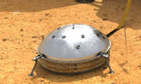
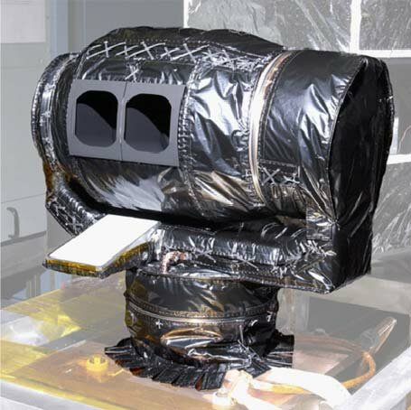
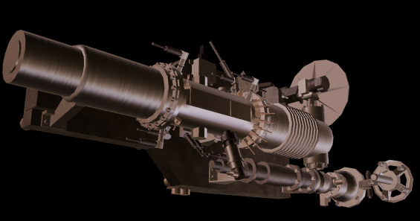
Orbiter and Probe Instruments (2/2)
MCS (Mars Climate Sounder)
Analyzing cloud layers and composition
MASPEX (Mass Spectrometer for Planetary Exploration)
Study composition of Venus atmosphere to determine planets geology and climate history
SEIS (Seismic Experiment for Interior Structure
Gain insight on the interior of Venus through seismic vibrations
Courtesy: NASA

Slide 25
Power Analysis Overview
Assumptions
Source-to-loads transmission efficiency X_{SL} : 0.95
Array-to-battery transmission efficiency X_{AB} : 0.70
Battery-to-loads transmission efficiency X_{BL} : 0.96
Used planets’ gravitational parameter
Circular orbits
Cases
Low Earth Orbit (LEO): Altitude of 200 km
Near Venus Surface: Altitude of 50 km

Slide 26
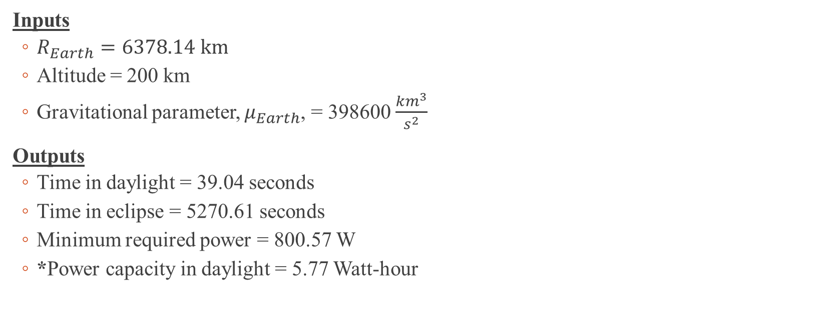
Case 1 Analysis (LEO)
Inputs
$R_{Earth}=6378.14 km$
Altitude = 200 km
Gravitational parameter, $μ_{Earth}$, = 398600 $\frac{{km}^{3}}{s^{2}}$
Outputs
Time in daylight = 39.04 seconds
Time in eclipse = 5270.61 seconds
Minimum required power = 800.57 W
*Power capacity in daylight = 5.77 Watt-hour

Slide 27
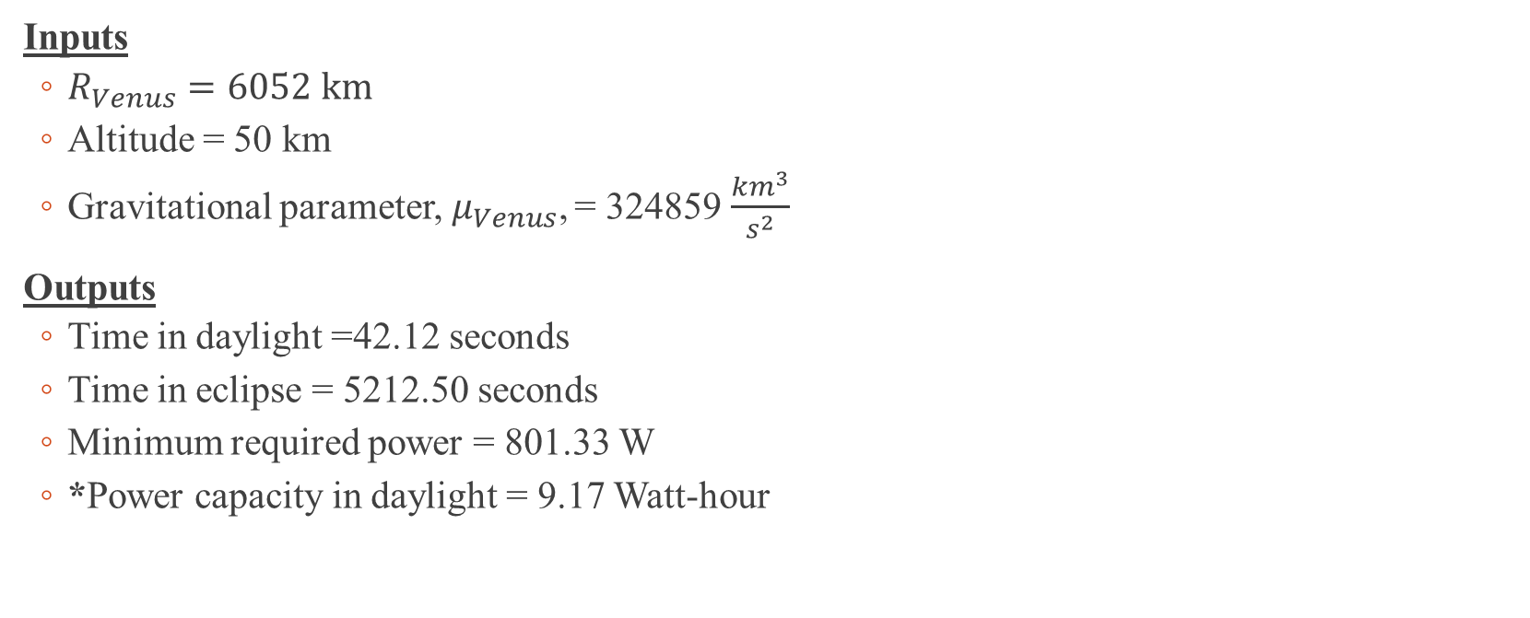
Case 2 Analysis (Near Venus Surface)
Inputs
$R_{Venus}=6052 km$
Altitude = 50 km
Gravitational parameter,${ μ}_{Venus}$, = 324859 $\frac{{km}^{3}}{s^{2}}$
Outputs
Time in daylight =42.12 seconds
Time in eclipse = 5212.50 seconds
Minimum required power = 801.33 W
*Power capacity in daylight = 9.17 Watt-hour

Slide 28
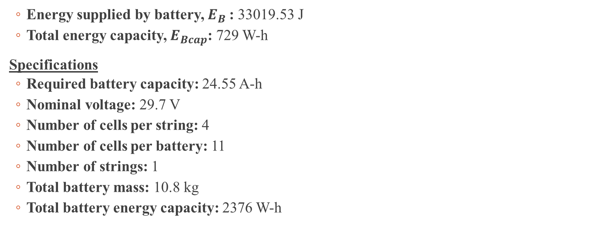
Battery Sizing (Lithium)
Energy supplied by battery, $E_{B}$: 33019.53 J
Total energy capacity, $E_{Bcap}$: 729 W-h
Specifications
Required battery capacity: 24.55 A-h
Nominal voltage: 29.7 V
Number of cells per string: 4
Number of cells per battery: 11
Number of strings: 1
Total battery mass: 10.8 kg
Total battery energy capacity: 2376 W-h

Slide 29
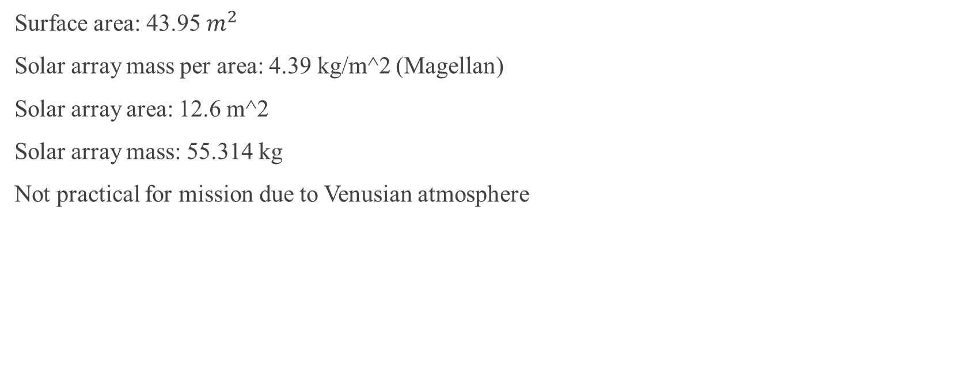
Solar Array Sizing
Surface area: 43.95 $m^{2}$
Solar array mass per area: 4.39 kg/m^2 (Magellan)
Solar array area: 12.6 m^2
Solar array mass: 55.314 kg
Not practical for mission due to Venusian atmosphere

Slide 30
Alternate Power Source (Fuel Cells)
Power Source | Voltage (V) | Duration | Energy Capacity (WH) | Volume (m^3)
Fuel Cell | 28 | 1 month | 899201.52 | 0.55
Li/CFX | 28 | 10 years | 784 | 7.90 x 10^-4
MMRTG | 28 | 10 years | N/A | N/A

Slide 31
Power System Block Diagram
Payload
Attitude Determination and Control System
Fuel Cell
LOX Tank
LH2 Tank
Communication System
Gas Release System
Power Conditioning Unit (PCU)
Thermal Control Unit
Regulator
Guidance Navigation and Control

Slide 32
Orbiter Mass Statement (1/2)
Spacecraft Mass Statement
Subsystem | Budget (kg) | Current (kg) | Status
Payload | 117 | 105.931 | E
Structure | 260 | 260 | E
Thermal Control | 78 | 78 | E
Power | 195 | 195 | E
TT&C | 91 | 91 | E
On-Board Processing | 52 | 52 | E
ADC | 78 | 78 | E
Propulsion | 130 | 130 | E
Other (balance + launch) | 39 | 39 | E
Budget Total | 1040 | 1028.931
Margin | 1976 | 1954.9689

Slide 33
Orbiter Mass Statement (2/2)
Spacecraft Mass Statement
Subsystem | Budget (kg) | Current (kg) | Status
On-Orbit Dry | 1976 | 1954.9689
Propellant | 1430 | 848.3200363 | E
Pressurant | 6.3982061 | 3.795612889 | E
ON-ORBIT WET | 3406 | 2803.288936
Adapter | 307.153 | 261.6483147 | C
Launch Mass | 3713.153 | 3064.937251 | E

Slide 34
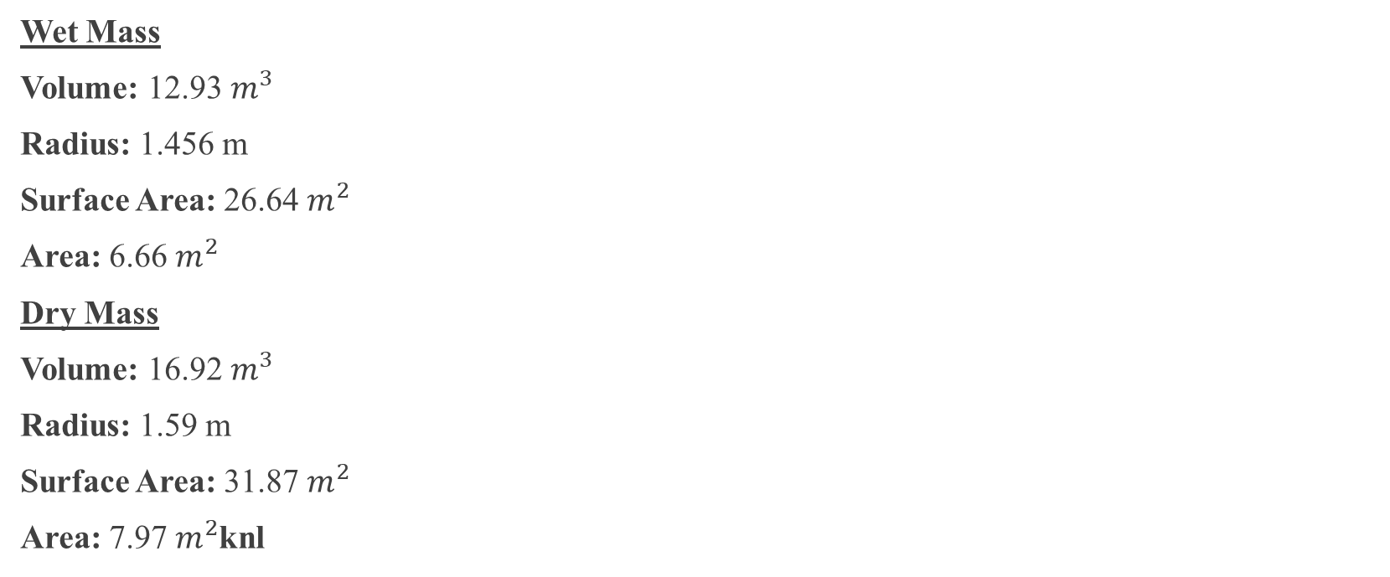
Spherical Assumptions
Wet Mass
Volume: 12.93 $m^{3}$
Radius: 1.456 m
Surface Area: 26.64 $m^{2}$
Area: 6.66 $m^{2}$
Dry Mass
Volume: 16.92 $m^{3}$
Radius: 1.59 m
Surface Area: 31.87 $m^{2}$
Area: 7.97 $m^{2}$knl

Slide 35
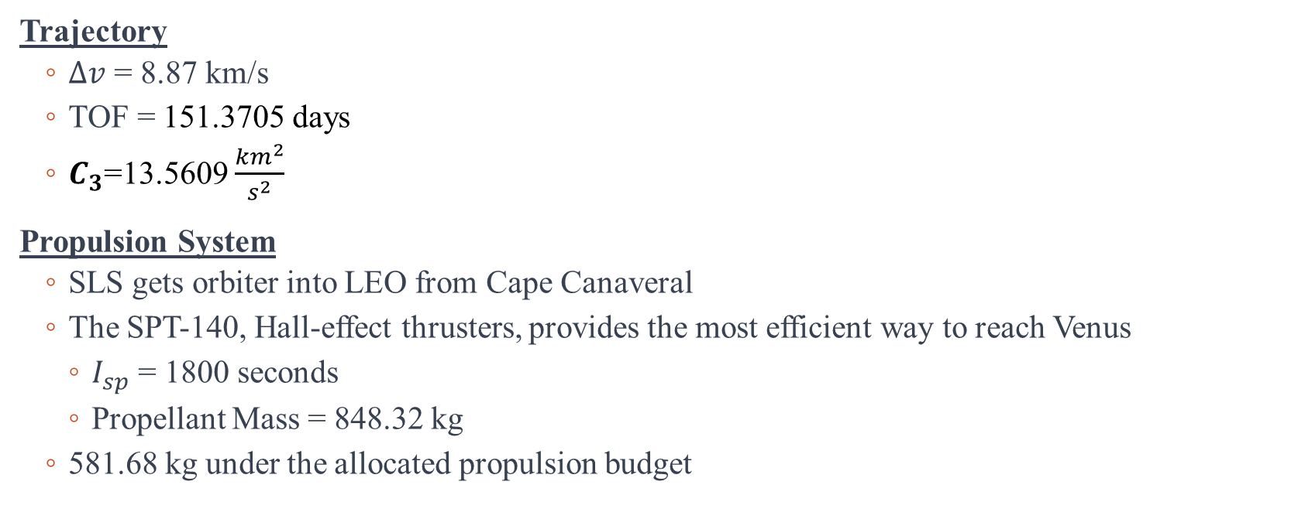
Conclusion
Trajectory
$Δv$ = 8.87 km/s
TOF = 151.3705 days
$C_{3}$=13.5609 $\frac{{km}^{2}}{s^{2}}$
Propulsion System
SLS gets orbiter into LEO from Cape Canaveral
The SPT-140, Hall-effect thrusters, provides the most efficient way to reach Venus
$I_{sp}$ = 1800 seconds
Propellant Mass = 848.32 kg
581.68 kg under the allocated propulsion budget
Notes:
Design A
Total time = 302.74 days
Total DV = 17.74 km/s
Design B
Total time = 292.14 days
Total DV = 13.3141 km/s

Slide 36
Reference Slide
[1] Brown, C. D. (2002). Elements of spacecraft design. American Institute of Aeronautics and Astronautics, Inc.
[2] Edberg, D. (2022). Spacecraft Design, Development, & Operation.
[3] Europa Clipper Instrument Summaries. (n.d.-a). https://europa.nasa.gov/internal_resources/379/ScienceInstruments_031422_Public.pdf
[4] Instructions for competitors obtaining own launch RevB - NASA. (n.d.-b). https://www.nasa.gov/wp-content/uploads/2023/02/instructions-for-competitors-obtaining-own-launch-revb.pdf
[5] NASA. (n.d.-a). Artemis. NASA. https://www.nasa.gov/specials/artemis/
[6] NASA. (2023, February 16). Maspex. NASA. https://europa.nasa.gov/spacecraft/instruments/maspex/
[7] NASA. (n.d.-b). NASA Technical Reports Server (NTRS). NASA. https://ntrs.nasa.gov/
[8] NASA. (n.d.-b). Radar Imager for mars’ subsurface exploration (RIMFAX). NASA. https://mars.nasa.gov/mars2020/spacecraft/instruments/rimfax/

Slide 37
Reference Slide
[9] Space mission engineering: The new smad. (2011). . Amazon Publishing.
[10] Wikimedia Foundation. (2023, October 5). Xenon. Wikipedia. https://en.wikipedia.org/wiki/Xenon
[11] Wikimedia Foundation. (2023a, October 1). Psyche (spacecraft). Wikipedia. https://en.wikipedia.org/wiki/Psyche_(spacecraft)

Slide 38
Thermal Design

Slide 40
Orbiter Mass Statement (1/2)
Spacecraft Mass Statement
Subsystem | Budget (kg) | Current (kg) | Status
Payload | 377.00 | 105.93 | C
Structure | 37000.00 | 35328.86 | C
Thermal Control | 1378.00 | 1015.00 | C
Power | 195.00 | 304.81 | C
TT&C | 91.00 | 91.00 | E
On-Board Processing | 52.00 | 52.00 | E
ADC | 78.00 | 78.00 | E
Propulsion | 130.00 | 4700.14 | C
Other (balance + launch) | 39.00 | 39.00 | E
TPS | 0.00 | 2516.99 | C
Budget Total | 39340.00 | 37014.61
Margin | 13769.00 | 8877.27

Slide 41
Orbiter Mass Statement (2/2)
Spacecraft Mass Statement
Subsystem | Budget (kg) | Current (kg) | Status
On-Orbit Dry | 39340.00 | 37014.61
Propellant | 100000.00 | 144078.67 | C
Pressurant | 447.43 | 644.65 | C
ON-ORBIT WET | 139340.00 | 181093.28
Adapter | 10570.17 | 13722.54 | C
Launch Mass | 149910.17 | 202032.95 | C

Slide 42
Orbiter Power Statement
Spacecraft Power Statement
Subsystem | Budget (W) | Current (W) | Status
Thermal Control | 170.369367 | 16.2496726 | C
Attitude Control | 121.692405 | 121.692405 | E
Power | 60.8462024 | 60.8462024 | C
CDS | 103.438544 | 103.438544 | E
COMMs | 139.946265 | 139.946265 | E
Propulsion | 6.08462024 | 6.08462024 | C
Mechanism | 6.08462024 | 6.08462024 | E
Total | 608.462024 | 454.34233 | E
Margin | 0 | 154.119694 | E
Payload | 170 | 144.2 | E
ON ORBIT POWER | 778.462024 | 598.54233

Slide 43
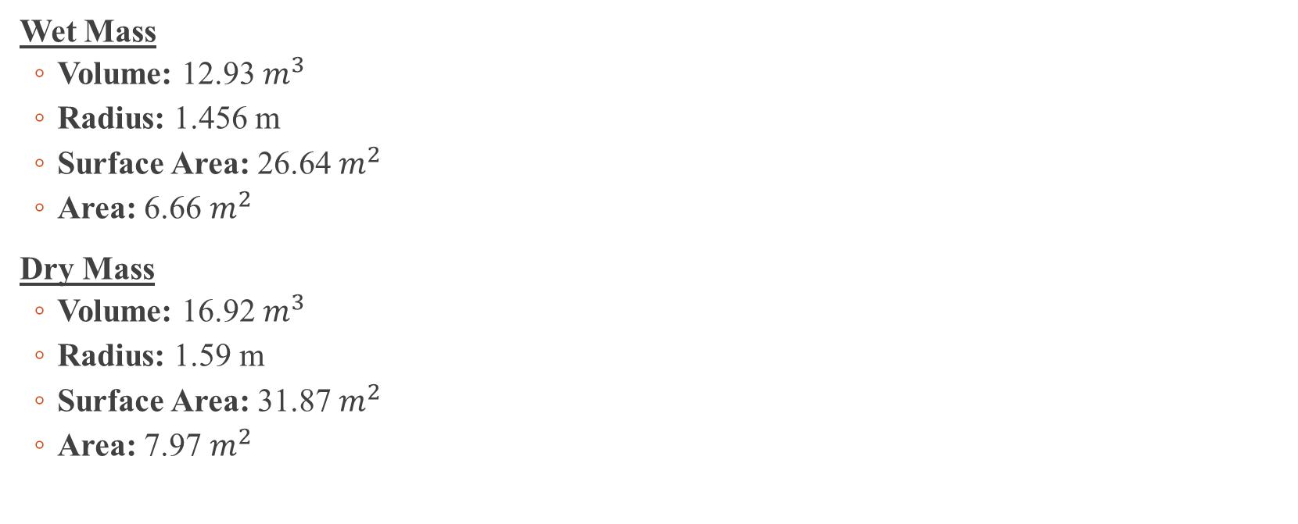
Thermal Analysis (Spherical Assumptions)
Wet Mass
Volume: 12.93 $m^{3}$
Radius: 1.456 m
Surface Area: 26.64 $m^{2}$
Area: 6.66 $m^{2}$
Dry Mass
Volume: 16.92 $m^{3}$
Radius: 1.59 m
Surface Area: 31.87 $m^{2}$
Area: 7.97 $m^{2}$

Slide 44
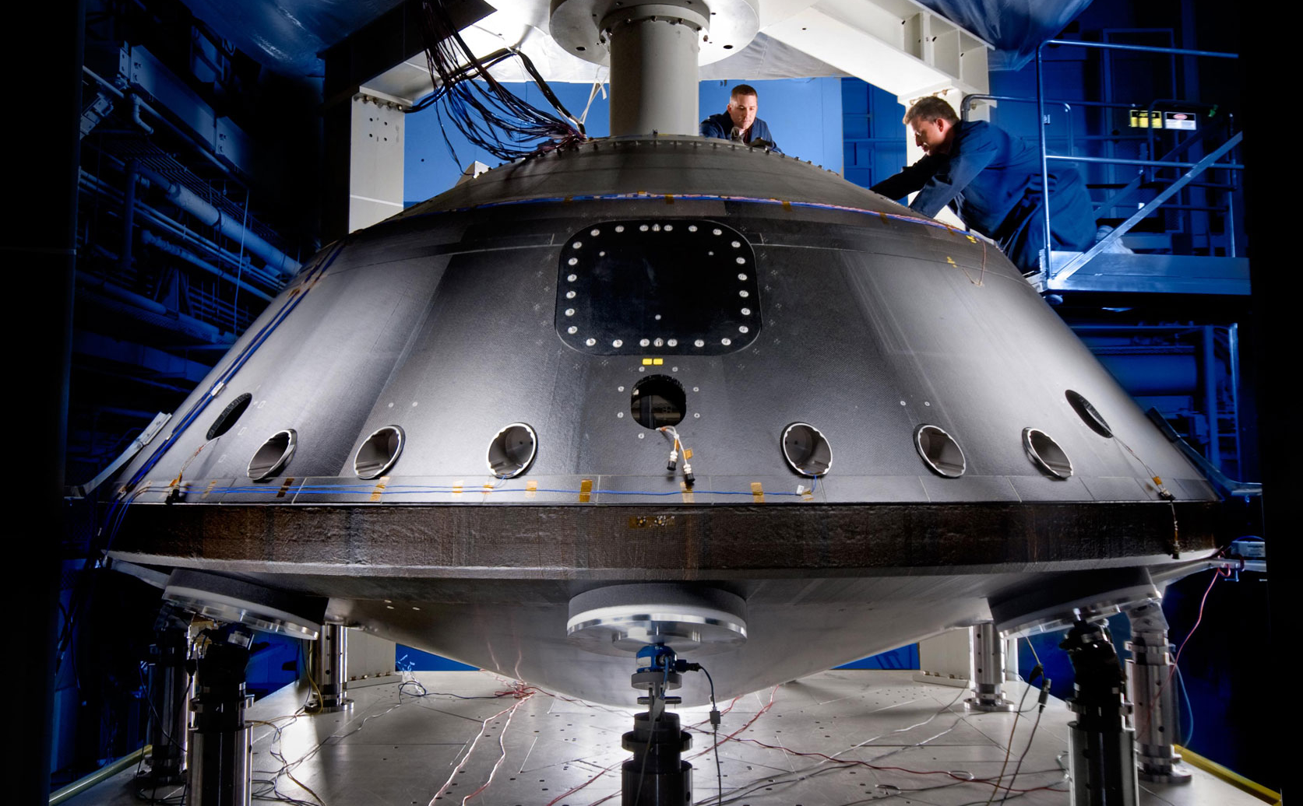
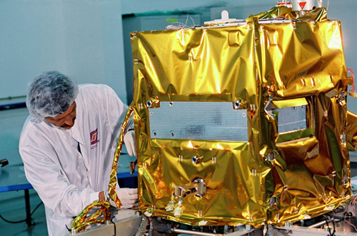
Thermal Analysis
Inputs
Maximum Power Dissipation: 144.2 W
Minimum Power Dissipation: 80 W
Altitude: 55 km
Venus Radius: 6052 km
IR Emissivity: 0.8
Solar Absorptivity: 0.316
Outputs
Worse case (Hot/Cold): 273 K / 208 K
Radiator Area: 2.59 m^2
Radiator Temperature (Worst Case Cold): 171 K
Heater Power Required: 16.2 W
Solar Array Temperature (Hot / Cold): 54.5 K / 41.5 K

Slide 45
Conclusion
Thermal Analysis
Worse case (Hot/Cold): 273 K / 208 K
Radiator Area: 2.59 m^2
Radiator Temperature (Worst Case Cold): 171 K
Heater Power Required: 16.2 W
Solar Array Temperature (Hot / Cold): 54.5 K / 41.5 K
Spacecraft Budgets
Total Mass: 3833.79 kg (14.36% under budget)
Total Power: 598.54 W (30.06% under budget)
Values close to Perseverance Rover mission and Venus Express, but under Europa Clipper’s
Notes:
Design A
Total time = 302.74 days
Total DV = 17.74 km/s
Design B
Total time = 292.14 days
Total DV = 13.3141 km/s

Slide 46

Thank you!

Slide 47
Power Design

Slide 48
Power Analysis Overview
Assumptions
Source-to-loads transmission efficiency X_{SL} : 0.95
Array-to-battery transmission efficiency X_{AB} : 0.70
Battery-to-loads transmission efficiency X_{BL} : 0.96
Used the planets’ gravitational parameter
Circular orbits to simplify calculations
Cases
Low Earth Orbit (LEO): Altitude of 200 km
Near Venus Surface: Altitude of 50 km

Slide 49
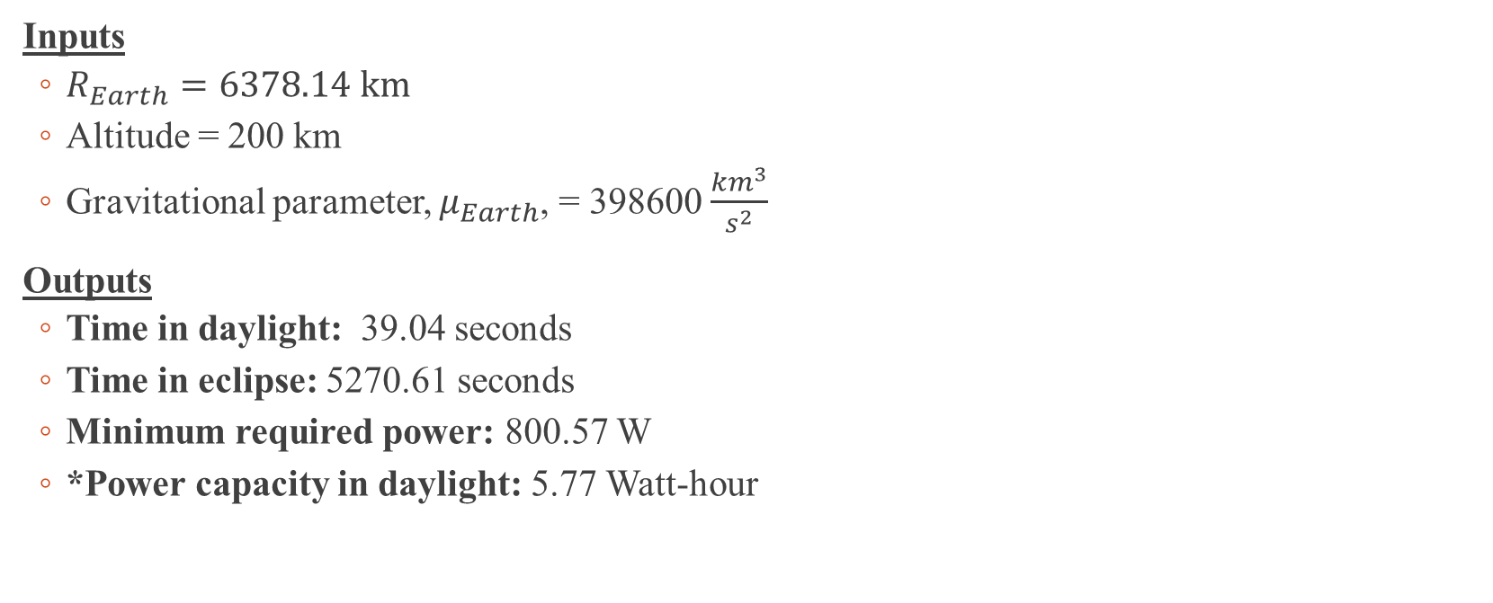
Case 1 Analysis (LEO)
Inputs
$R_{Earth}=6378.14 km$
Altitude = 200 km
Gravitational parameter, $μ_{Earth}$, = 398600 $\frac{{km}^{3}}{s^{2}}$
Outputs
Time in daylight: 39.04 seconds
Time in eclipse: 5270.61 seconds
Minimum required power: 800.57 W
*Power capacity in daylight: 5.77 Watt-hour

Slide 50

Case 2 Analysis (Near Venus Surface)
Inputs
$R_{Venus}=6052 km$
Altitude = 50 km
Gravitational parameter,${ μ}_{Venus}$, = 324859 $\frac{{km}^{3}}{s^{2}}$
Outputs
Time in daylight: 42.12 seconds
Time in eclipse: 5212.50 seconds
Minimum required power: 801.33 W
*Power capacity in daylight: 6.28 Watt-hour

Slide 51
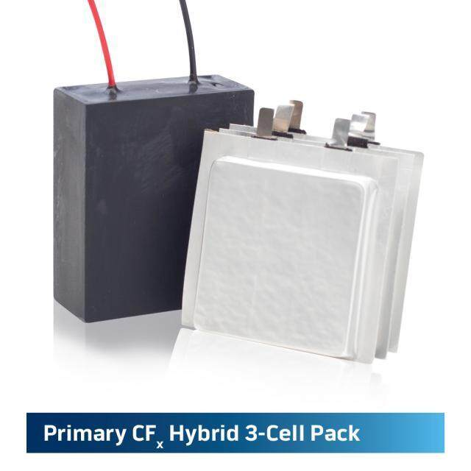
Battery Sizing (Lithium)
Energy supplied by battery, $E_{B}$: 33019.53 J
Total energy capacity, $E_{Bcap}$: 729 W-h
Specifications
Required battery capacity: 24.55 A-h
Nominal voltage: 29.7 V
Number of cells per string: 4
Number of cells per battery: 11
Number of strings: 1
Total battery mass: 10.8 kg
Total battery energy capacity: 2376 W-h
Courtesy:
Eagle Picher

Slide 52
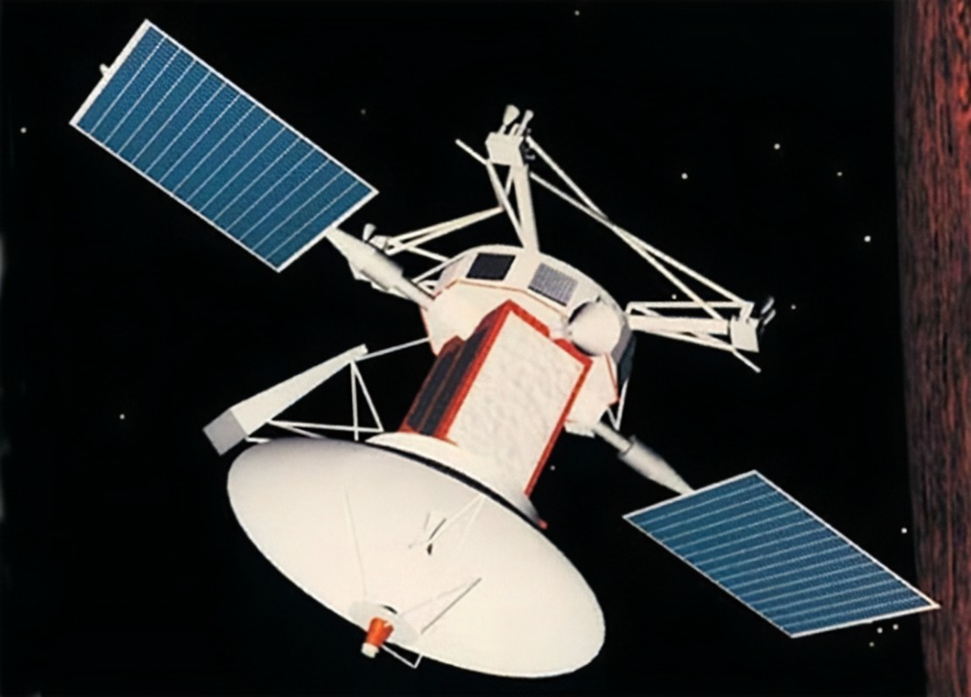
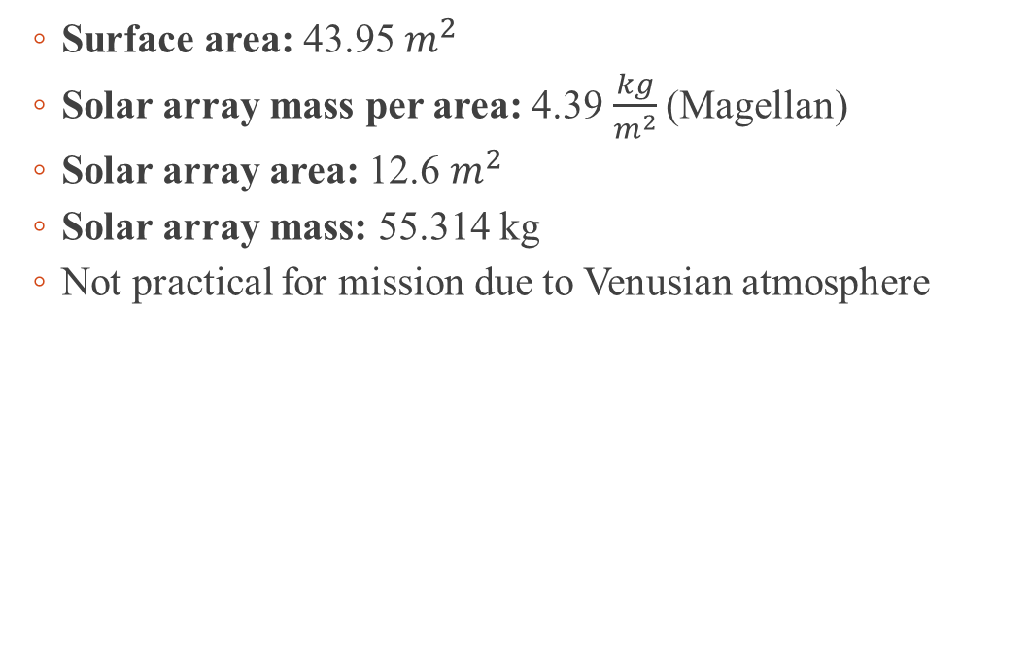
Solar Array Sizing
Surface area: 43.95 $m^{2}$
Solar array mass per area: 4.39 $\frac{kg}{m^{2}}$(Magellan)
Solar array area: 12.6 $m^{2}$
Solar array mass: 55.314 kg
Not practical for mission due to Venusian atmosphere
Courtesy:
NASA

Slide 53
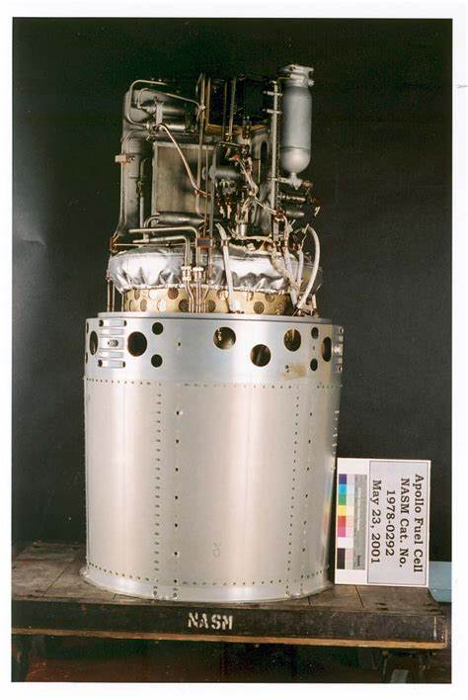
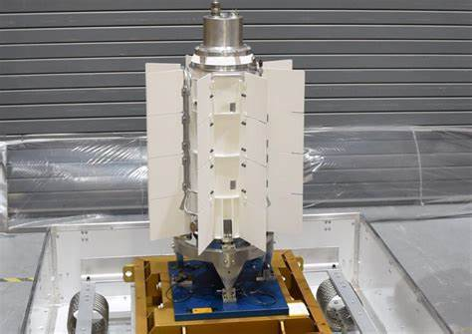
Alternate Power Source Trade Study
Power Source | Voltage (V) | Duration | Energy Capacity (WH) | Volume (m^3)
Fuel Cell | 28 | 1 month | 899201.52 | 0.55
Li/CFX | 28 | 10 years | 784 | 7.90 x 10^-4
MMRTG | 28 | 10 years | N/A | N/A

Slide 54
Power System Block Diagram
Payload
Attitude Determination and Control System
Fuel Cell
LOX Tank
LH2 Tank
Communication System
Gas Release System
Power Conditioning Unit (PCU)
Thermal Control Unit
Regulator
Guidance Navigation and Control

Slide 55
Orbiter Mass Statement (1/2)
Spacecraft Mass Statement
Subsystem | Budget (kg) | Current (kg) | Status
Payload | 377 | 105.931 | C
Structure | 260 | 260 | E
Thermal Control | 1378 | 1015 | C
Power | 195 | 304.8140729 | C
TT&C | 91 | 91 | E
On-Board Processing | 52 | 52 | E
ADC | 78 | 78 | E
Propulsion | 130 | 37.6679819 | C
Other (balance + launch) | 39 | 39 | E
Cables | 0 | 143.8302505 | C
Budget Total | 2600 | 2155.15
Margin | 0 | 484.85

Slide 56
Orbiter Mass Statement (2/2)
Spacecraft Mass Statement
Subsystem | Budget (kg) | Current (kg) | Status
On-Orbit Dry | 2600 | 2115.150743
Propellant | 1430 | 1380.249811 | C
Pressurant | 6.3982061 | 6.175610324 | C
ON-ORBIT WET | 4030 | 3495.400554
Adapter | 354.265 | 313.9027419 | C
Launch Mass | 4384.265 | 3809.303296 | E

Slide 57
Orbiter Power Statement
Spacecraft Power Statement
Subsystem | Budget (W) | Current (W) | Status
Thermal Control | 170.369367 | 16.24967261 | C
Attitude Control | 121.692405 | 121.6924048 | E
Power | 60.8462024 | 6.283912758 | C
CDS | 103.438544 | 103.438544 | E
COMMs | 139.946265 | 139.9462655 | E
Propulsion | 6.08462024 | 2.42 | C
Mechanism | 6.08462024 | 6.084620238 | E
Total | 608.462024 | 396.1154199
Margin | 0 | 212.3466039
Payload | 170 | 144.2 | C
ON ORBIT POWER | 778.462024 | 540.3154199

Slide 58

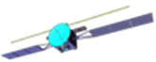



Communication ConOps
S-band comms. Orbiter and crew module
X-band comms. crew module and Earth
Alpha Regio

Slide 59




Science Instruments (2/2)
Atmospheric Structure Investigation Instrument
Measure atmospheric pressure & temperature during EDL
Descent Imager
Provide high quality imaging from under the clouds to the surface
Seismometer
Gain insight on the interior of Venus through seismic vibrations
1985 Venus International Reference Atmosphere (VIRA)
Upper hazy sulfuric acid cloud layer
Thick concentrated sulfuric acid clouds
Fine haze of sulfuric acid droplets & dust
Clear layer of carbon dioxide

Slide 60






Probe Deployment and Science ConOps
60
Analyze the layer most like Earths atmosphere (60 – 50 km)
50
Investigate the thick sulfuric cloud coverage (60 – 40 km)
40
Study high altitude atmospheric gases (50 – 40 km)
Altitude (km)
30
Explore the atmosphere below the clouds (40 km – surface)
20
Obtain knowledge of surface geology (20 km – surface)
10
Measure clear layer of carbon dioxide (10 km – surface)
0
Utilize seismometer to study below the regolith (surface)

Slide 61

Probe Orbit
60
Circumnavigation 1
Circumnavigation +n
50
40
30
20
Altitude (km)
15
10
5
0
0
120
240
Time (Earth Hours)

Slide 62
Structural Design

Slide 64

Mass and volume of Electronics
Subsystem | Mass (kg) | Volume ($m^{3}$)
ACS | 78 | 0.24
Power | 304.81 | 0.27
C&DH | 52 | 0.16
Telecommunications | 91 | 0.28

Slide 65


Spacecraft First Look
Volume: 14.03 $m^{3}$
Surface area: 266.38 $m^{2}$
Mass of launch vehicle adapter: 783.50 kg
Total mass: 35328.86 kg

Slide 66

Exploded-View and Call-outs
Cruise stage
Dinitrogen tank
Monomethyl hydrazine tank
Back shell
Folded balloon
Payload structure
MASPEX
Fuel cell
Telecommunications
CD&H
Helium tank
MARCI
SEIS
TLS
Heat shield

Slide 67

4-View Drawing of Spacecraft

Slide 68


Payload detached from aeroshell
Volume: 3$.36 m^{3}$
Surface area: 63.45 $m^{2}$

Slide 69


Mass Properties and Stability
Spacecraft within Aeroshell
Center of mass (meters):
X = 0
Y = 0.28
Z = -0.29
Moment of Inertia (kg-$m^{2})$
$I_{xx}$ = 76222.31
$I_{yy}$ = 703926.38
$I_{zz}$ = 74078.52
$I_{xy}$ = 200.54
$I_{xz}$ = 63.69
$I_{yx}$ = 200.54
$I_{yz}$ =-2733.40
$I_{zx}$ = 63.69
$I_{zy}$ = -2733.40
Spacecraft without Aeroshell
Center of mass (meters):
X = -0.04
Y = 0.69
Z = -0.31
Moment of Inertia (kg-$m^{2})$
$I_{xx}$ = 4970.46
$I_{yy}$ = 4817.15
$I_{zz}$ = 4788.66
$I_{xy}$ = -68.52
$I_{xz}$ = 59.93
$I_{yx}$ = -68.52
$I_{yz}$ = -721.32
$I_{zx}$ = 59.93
$I_{zy}$ = -721.32

Slide 70
Orbiter Mass Statement (1/2) - All
Spacecraft Mass Statement
Subsystem | Budget (kg) | Current (kg) | Status
Payload | 377.00 | 105.93 | C
Structure | 37000.00 | 32734.63 | C
Thermal Control | 1378.00 | 1015.00 | C
Power | 195.00 | 304.81 | C
TT&C | 91.00 | 91.00 | E
On-Board Processing | 52.00 | 52.00 | E
ADC | 78.00 | 78.00 | E
Propulsion | 130.00 | 4380.12 | C
Other (balance + launch) | 39.00 | 39.00 | E
TPS | 0.00 | 2340.59 | C
Budget Total | 39340.00 | 34420.38
Margin | 13769.00 | 105.93

Slide 71
Orbiter Mass Statement (2/2) - All
Spacecraft Mass Statement
Subsystem | Budget (kg) | Current (kg) | Status
On-Orbit Dry | 39340.00 | 34420.38
Propellant | 100000.00 | 133980.68 | C
Pressurant | 447.43 | 599.47 | C
ON-ORBIT WET | 139340.00 | 168401.06
Adapter | 10570.17 | 12764.28 | C
Launch Mass | 149910.17 | 187886.04 | C

Slide 72
Orbiter Mass Statement (1/2) - SC
Spacecraft Mass Statement
Subsystem | Budget (kg) | Current (kg) | Status
Payload | 377.00 | 105.93 | C
Structure | 260.00 | 2415.75 | C
Thermal Control | 1378.00 | 1015.00 | C
Power | 195.00 | 304.81 | C
TT&C | 91.00 | 91.00 | E
On-Board Processing | 52.00 | 52.00 | E
ADC | 78.00 | 78.00 | E
Propulsion | 130.00 | 570.16 | C
Other (balance + launch) | 39.00 | 39.00 | E
TPS | 0.00 | 2340.59 | C
Budget Total | 2600.00 | 4101.50
Margin | 910.00 | -591.50

Slide 73
Orbiter Mass Statement (2/2) - SC
Spacecraft Mass Statement
Subsystem | Budget (kg) | Current (kg) | Status
On-Orbit Dry | 2600.00 | 4101.50
Propellant | 1430.00 | 15964.99 | C
Pressurant | 6.40 | 71.43 | C
ON-ORBIT WET | 4030.00 | 20066.49
Adapter | 354.27 | 1565.02 | C
Launch Mass | 4384.27 | 24542.26 | C

Slide 74
List of Mechanisms
Mechanisms | Connection | Purpose
Cruise module detachment | Aeroshell | Detaches the cruise module from the system to reduce mass during entry
Aeroshell hatch | Aeroshell | Opens to allow the parachute to inflate and balloon soon after
Heat shield ejector | Back shell | Removes the heat shield to reduce mass during entry
Back shell ejector | Payload structure | Removes back shell to allow the balloon to expand outwards
Gas valve system | Payload structure | Inflates the balloon, which will be controlled by the team after
On-board thrusters/propellers | Payload structure | Controlled by the team to navigate the balloon to desired locations

Slide 75

Conclusion
Spacecraft Overview
Volume: 14.03 $m^{3}$
Surface area: 266.38 $m^{2}$
Mass of launch vehicle adapter: 783.50 kg
Total mass: 35328.86 kg
Spacecraft Budgets
Total Mass: 24542.26 kg (20.2% over budget)
Within SLS’s payload mass capacity of 37,901 kg
Notes:
Design A
Total time = 302.74 days
Total DV = 17.74 km/s
Design B
Total time = 292.14 days
Total DV = 13.3141 km/s

Slide 76


With Aeroshell
Without Aeroshell

Slide 77
Control System

Slide 79

Exploded-View and Call-outs
Cruise stage
Dinitrogen tank
Monomethyl hydrazine tank
Back shell
Folded balloon
Payload structure
MASPEX
Fuel cell
Telecommunications
CD&H
Helium tank
MARCI
SEIS
TLS
ACS
Heat shield

Slide 80
Exploded-View (ADC Specific)
Dinitrogen tank
4x Thrusters
Monomethyl hydrazine tank
Dinitrogen tank
Monomethyl hydrazine tank
4x Thrusters
ACS

Slide 81


Top and Side View
Top View
Side View
Y
1.0 meters
1.07 meters
4.0 meters
1.39 meters
Z
5.0 meters

Slide 82

Mass Properties and Stability
Spacecraft within Aeroshell
Center of mass (meters):
X = 0.01
Y = 0.76
Z = -0.30
Moment of Inertia (kg-$m^{2})$
$I_{xx}$ = 44451.50
$I_{yy}$ = 45161.45
$I_{zz}$ = 44017.00
$I_{xy}$ = 378.08
$I_{xz}$ = 108.92
$I_{yx}$ = 378.08
$I_{yz}$ = -3273.58
$I_{zx}$ = 108.92
$I_{zy}$ = -3273.58
Spacecraft without Aeroshell
Center of mass (meters):
X = -0.04
Y = 0.69
Z = -0.31
Moment of Inertia (kg-$m^{2})$
$I_{xx}$ = 4970.46
$I_{yy}$ = 4817.15
$I_{zz}$ = 4788.66
$I_{xy}$ = -68.52
$I_{xz}$ = 59.93
$I_{yx}$ = -68.52
$I_{yz}$ = -721.32
$I_{zx}$ = 59.93
$I_{zy}$ = -721.32

Slide 83

ACS Engine Option 1
MOOG MONARC-1
1000+ used on space vehicles
Proven heritage in space applications

Slide 84

ACS Engine Option 2
ECAPS 1N HPGP Thruster
102 currently in space
First flown on Prisma satellite (June 2010)

Slide 85

ACS Engine Option 3
ArianeGroup 1N Monopropellant Thruster
500+ successful space operations
First flown on the Asterix 1 satellite in 1965

Slide 86

ACS Engine Option 4
Aerojet Rocketdyne MR-103 1N
Flight proven 1000+ on space vehicles
First flown ATS 6 comsat (May 1974)

Slide 87

ACS Engine Option 5
Aerojet Rocketdyne MR-111E 2N
Flight proven 500+ on space vehicles
First flown Intelsat 5 (December 1980)

Slide 88
Attitude Control System Engine Options
 | MONARC-1 | 1N HPGP Thruster | 1N Monopropellant Thruster | MR-103D 1N | MR-111E 2N
Supplier | MOOG | ECAPS | ArianeGroup | Aerojet Rocketdyne | Aerojet Rocketdyne
Mass (kg) | 0.38 | 0.39 | 0.29 | 0.33 | 0.33
L x W (m) | 0.113 x 0.05 | 0.178 x 0.05* | 0.172 x 0.046 | 0.146 x 0.071 | 0.169 x 0.074
Power (W) | 18 | 12 | N/A | 13.7 | 13.6
Isp (sec) | 227.5 | 226.1 | 220 | 224 | 224
Propellant | Hydrazine | LMP-103S | Hydrazine | Hydrazine | Hydrazine
Engine
Characteristics
LMP-103S is a High-Performance Green Propellant (HPGP) offering up to a 30% better performance per volume than hydrazine according to the manufacturer ECAPS.
HPGP also contributes to Planet Protection Protocols.
*Estimated value

Slide 89

Selected ACS Engine
Engine: 1N HPGP Thruster
Supplier: ECAPS
Mass: 0.39 kg
Dimensions: 0.172 x 0.05* m
ISP: 226.1 seconds
Propellant: LMP-103S

Slide 90

Attitude Control System Thruster
Mass: 0.38 kg
Size: 0.178 m x .1m x .1m
Isp: 231 seconds
Supplier: ECAPS

Slide 91
Aeroshell Time vs Euler Angles

Slide 92
Aeroshell Time vs Angular Velocity

Slide 93
Aeroshell Time vs Acceleration

Slide 94
Aeroshell Time vs Torque

Slide 95
Aeroshell Time vs Propellant Mass

Slide 96
Spacecraft Time vs Euler Angles

Slide 97
Aeroshell Time vs Angular Velocity

Slide 98
Aeroshell Time vs Acceleration

Slide 99
Spacecraft Time vs Torque

Slide 100
Aeroshell Time vs Propellant Mass

Slide 101

Worst Case Scenario (Aeroshell)
Assumptions:
Magnetic field is negligible on Venus
$C_{D}=1.1 based on past missions and public knowledge$
$A_{critical}$ = 19.63$m^{2}$
$T_{Solar Radiation}$ = [1.66, 1.66, 1.66] x ${10}^{−4}$ N-m
$T_{Atmospheric}$ = [21.56, 20.89, 21.99] N-m
$T_{Gravity gradient}$ = [-21.20, -20.21, -21.83] N-m
$T_{Magnetic}$ = [0, 0, 0] N-m

Slide 102

Worst Case Scenario (Spacecraft)
Assumptions:
Magnetic field is negligible on Venus
$C_{D}=1.1 based on past missions and public knowledge$
$A_{critical}$ = 7$.07 m^{2}$
$T_{Solar Radiation}$ = [5.96, 1.66, 1.66] x ${10}^{−5}$ N-m
$T_{Atmospheric}$ = [7.06, 7.52, 7.61] N-m
$T_{Gravity gradient}$ = [-0.457, -0.50, -0.51] N-m
$T_{Magnetic}$ = [0, 0, 0] N-m

Slide 103

Reaction Wheel Unloading (Aeroshell)
Assumptions
Momentum capacity: 12 N-m-s
Torque: 0.2 N-m
Spin-up time: 60 seconds
Spin-down time: 60 seconds
Outputs
Total time to unload: 3.81 seconds
Propellant needed: .0015 kg
Courtesy:
Honeywell

Slide 104
Reaction Wheel Unloading (Spacecraft)
Assumptions
Momentum capacity: 12 N-m-s
Torque: 0.2 N-m
Spin-up time: 60 seconds
Spin-down time: 60 seconds
Outputs
Total time to unload: 35.68 seconds
Propellant needed: .001 kg
Courtesy:
Honeywell

Slide 105

Propulsion System Schematic (Aeroshell)

Slide 106
ACS Block Diagram (Aeroshell)
Star Tracker
Reaction Wheels
2 x Computer
Power *PCI Bridge
Sun Sensors
Central Moment Gyroscopes
RAD750 CPU
Magnetometer
Memory
Thrusters
* Peripheral Component Interconnect

Slide 107
Propulsion System Schematic (Spacecraft)
For the moment, the aeroshell and spacecraft shall the same propulsion set-up until a more in-depth review

Slide 108
ACS Block Diagram (Spacecraft)
2 x Computer
Sun Sensors
Reaction Wheels
Power *PCI Bridge
RAD750 CPU
Magnetometer
Central Moment Gyroscopes
Memory
* Peripheral Component Interconnect

Slide 109
Aeroshell ADC Components
Aeroshell
Component | Quantity | Mass (kg) | Power (W) | Supplier | Total Line Mass (kg) | Total Line Power (W)
Star Tracker | 1 | 0.042 | 0.685 | AAC Clyde Space | 0.042 | 0.685
Sun Sensors | 1 | 0.029 | 5 | AAC Clyde Space | 0.029 | 5
Magnetometers | 1 | 0.1 | 1.02 | AAC Clyde Space | 0.1 | 1.02
RWAs | 1 | 9.5 | 22 | Honeywell | 9.5 | 22
CMGs | 1 | 1.9 | 12 | GranStal Solutions | 1.9 | 12
Computers | 1 | 0.549 | 35 | BAE Systems | 0.549 | 35
Thrusters | 4 | 0.38 | 10 | ECAPs | 1.52 | 40
 |  |  |  | Total | 13.64 | 115.705

Slide 110
Spacecraft ADC Components
Spacecraft
Component | Quantity | Mass (kg) | Power (W) | Supplier | Total Line Mass (kg) | Total Line Power (W)
Magnetometers | 1 | 0.1 | 1.02 | AAC Clyde Space | 0.1 | 1.02
CMGs | 1 | 1.9 | 12 | GranStal Solutions | 1.9 | 12
Computers | 1 | 0.549 | 35 | BAE Systems | 0.549 | 35
 |  |  |  | Total | 2.549 | 48.02

Slide 111
Orbiter Mass Statement (1/2) - All
Spacecraft Mass Statement
Subsystem | Budget (kg) | Current (kg) | Status
Payload | 377.00 | 105.93 | C
Structure | 37000.00 | 14482.92 | C
Thermal Control | 1378.00 | 1015.00 | C
Power | 195.00 | 304.81 | C
TT&C | 91.00 | 91.00 | E
On-Board Processing | 52.00 | 52.00 | E
ADC | 78.00 | 35.28 | C
Propulsion | 130.00 | 2104.97 | C
Other (balance + launch) | 39.00 | 39.00 | E
TPS | 0.00 | 1096.56 | C
Budget Total | 39340.00 | 16125.94
Margin | 13769.00 | 33781.53

Slide 112
Orbiter Mass Statement (2/2) - All
Spacecraft Mass Statement
Subsystem | Budget (kg) | Current (kg) | Status
On-Orbit Dry | 39340.00 | 16125.94
Propellant | 100000.00 | 62769.93 | C
Pressurant | 447.43 | 280.85 | C
ON-ORBIT WET | 139340.00 | 78895.87
Adapter | 10570.17 | 6006.64 | C
Launch Mass | 149910.17 | 88104.04 | C

Slide 113
Orbiter Mass Statement (1/2) - SC
Spacecraft Mass Statement
Subsystem | Budget (kg) | Current (kg) | Status
Payload | 377.00 | 105.93 | C
Structure | 260.00 | 3423.33 | C
Thermal Control | 1378.00 | 1015.00 | C
Power | 195.00 | 304.81 | C
TT&C | 91.00 | 91.00 | E
On-Board Processing | 52.00 | 52.00 | E
ADC | 78.00 | 5.10 | C
Propulsion | 130.00 | 148.76 | C
Other (balance + launch) | 39.00 | 39.00 | E
TPS | 0.00 | 1096.56 | C
Budget Total | 2600.00 | 5036.17
Margin | 910.00 | -1526.17

Slide 114
Orbiter Mass Statement (2/2) - SC
Spacecraft Mass Statement
Subsystem | Budget (kg) | Current (kg) | Status
On-Orbit Dry | 2600.00 | 5036.17
Propellant | 1430.00 | 3778.50 | C
Pressurant | 6.40 | 16.91 | C
ON-ORBIT WET | 4030.00 | 8814.67
Adapter | 354.27 | 715.51 | C
Launch Mass | 4384.27 | 10775.50 | C

Slide 115
Total System Power Statement
Spacecraft Power Statement
Subsystem | Budget (W) | Current (W) | Status
Thermal Control | 175.708471 | 17.2075243 | C
Attitude Control | 125.50605 | 328.43 | C
Power | 62.7530252 | 373.229155 | C
CDS | 106.680143 | 106.680143 | E
COMMs | 144.331958 | 144.331958 | E
Propulsion | 6.27530252 | 2.42 | C
Mechanism | 6.27530252 | 6.27530252 | E
Total | 627.530252 | 978.574082
Margin | 564.777227 | 213.733397
Payload | 170 | 152.7 | C
ON ORBIT POWER | 797.530252 | 1131.27408

Slide 116
Conclusion
Spacecraft Overview
Number of thrusters: 8 in total (4 for aeroshell and 4 for spacecraft)
Atmospheric and gravity gradient perturbations are the most significant
~150 seconds for each rotation to reach 180 degrees
Spacecraft Budgets
Total spacecraft mass: 10775.50 kg (60% over budget)
Within SLS’s payload mass capacity of 37,901 kg
Total spacecraft power: 1131.27W (30% over budget)
Notes:
Design A
Total time = 302.74 days
Total DV = 17.74 km/s
Design B
Total time = 292.14 days
Total DV = 13.3141 km/s

Slide 117
Communications

Slide 119
High-Gain Downlink Assumptions
DSN 34-meter HES station (T9.15)
Pointing accuracy: 0.1°
Transmitter power: 25W
Frequency: 8.42 GHz
Cable loss (transmitter to antenna): 0.62dB
Modulation index: 68°
2.5 meter parabolic dish
Polarization loss: 0.20 dB
Receiver cable loss: 0.0 dB
BER: 0.001

Slide 120

High-Gain Downlink Analysis
Maximum range (1.53 $x{10}^{8}$ km):
Carrier SNR achieved: 37.31 dB
Carrier link margin: 27.31 dB
Data symbol rate: -52.53 dB-Hz
SNR achieved: 12.66 dB
Data link margin: 8.16 dB
Minimum range (1.46 $x{10}^{8}$ km):
Carrier SNR achieved: 37.73 dB
Carrier link margin: 27.73 dB
Data symbol rate: -52.53 dB-Hz
SNR achieved: 13.07 dB
Data link margin: 8.57 dB
To achieve a data link margin greater than 10dB, a symbol rate of 125 sps would be required

Slide 121

High-Gain Emergency Uplink Assumptions
DSN 34-meter HES station (T9.15)
Pointing loss: 0.1 dB
Transmitter power: 30W
Frequency: 8.42 GHz
Cable loss (transmitter to antenna): 0 dB
Modulation index: 57.30°
2.5 meter parabolic dish
Polarization loss: 0.20 dB
Receiver cable loss: 0.0 dB
BER: 1 x ${10}^{−5}$
Symbol rate: 100 sps

Slide 122
High-Gain Uplink Analysis
Carrier SNR achieved: 37.93 dB
Carrier link margin: 27.93 dB
Data symbol rate: -50.00 dB-Hz
SNR achieved: 14.96 dB
Data link margin: 10.46 dB

Slide 123
C&DS and Telecommunications Block Diagram (Aeroshell and Spacecraft)
Power System
ADCS
2 x Computer
Power *PCI Bridge
Storage
Payload
RAD750 CPU
Thermal System
Memory
Communication Subsystem
* Peripheral Component Interconnect

Slide 124
Aeroshell Telecommunications Components
Aeroshell
Component | Quantity | Mass (kg) | Power (W) | Supplier | Total Line Mass (kg) | Total Line Power (W)
Computers | 2 | 0.55 | 35 | BAE Systems | 1.098 | 70
X-Band Transceiver | 1 | 0.2 | 16 | Spacecom | 0.2 | 16
X-Band Transponder | 1 | 3.2 | 15.8 | General Dynamics | 3.2 | 15.8
X-Band Antenna | 1 | 0.25 | 26 | CubeCom | 0.25 | 26
X-band Diplexer | 1 | 0.120 | 0 | CubeCom | 0.120 | 0
X-Band Splitter | 1 | 0.03 | 0 | CubeCom | 0.03 | 0
X-band Coupler | 1 | 0.035 | 0 | CubeCom | 0.035 | 0
X-Band Power Amplifier | 2 | 1.37 | 65.5 | General Dynamics | 2.74 | 131
 |  |  |  | Total | 7.67 | 258.8

Slide 125
Aeroshell C&DS Components
Aeroshell
Component | Quantity | Mass (kg) | Power (W) | Supplier | Total Line Mass (kg) | Total Line Power (W)
Computers | 2 | 0.549 | 35 | BAE Systems | 1.098 | 70
Storage | 3 | 0.75 | 5 | Mercury | 2.25 | 15
FPGA | 2 | 0.28 | 3 | STM | 0.56 | 6
 |  |  |  | Total | 3.908 | 91

Slide 126
Spacecraft Telecommunications Components
Spacecraft
Component | Quantity | Mass (kg) | Power (W) | Supplier | Total Line Mass (kg) | Total Line Power (W)
Computers | 2 | 0.549 | 35 | BAE Systems | 1.10 | 70
S-Band Transceiver | 1 | 0.2 | 15 | Spacecom | 0.2 | 15
S-Band Transponder | 1 | 2.722 | 46 | General Dynamics | 2.722 | 46
S-Band Antenna | 1 | 0.137 | 12 | CubeCom | 0.137 | 12
S-Band Diplexer | 1 | 0.22 | 0 | CubeCom | 0.22 | 0
S-Band Splitter | 1 | 0.02 | 0 | CubeCom | 0.02 | 0
S-Band Coupler | 1 | 0.032 | 0 | CubeCom | 0.032 | 0
S-Band Amplifier | 2 | 1.98 | 8.3 | General Dynamics | 3.96 | 16.6
 |  |  |  | Total | 8.389 | 159.6

Slide 127
Spacecraft C&DS Components
Aeroshell
Component | Quantity | Mass (kg) | Power (W) | Supplier | Total Line Mass (kg) | Total Line Power (W)
Computers | 2 | 0.549 | 35 | BAE Systems | 1.098 | 70
Storage | 3 | 0.75 | 5 | Mercury | 2.25 | 15
FPGA | 2 | 0.28 | 3 | STM | 0.56 | 6
 |  |  |  | Total | 3.908 | 91

Slide 128
Orbiter Mass Statement (1/2) - All
Spacecraft Mass Statement
Subsystem | Budget (kg) | Current (kg) | Status
Payload | 377.00 | 77.43 | C
Structure | 37000.00 | 4423.00 | C
Thermal Control | 1378.00 | 1015.00 | C
Power | 195.00 | 304.81 | C
TT&C | 91.00 | 16.06 | C
On-Board Processing | 52.00 | 7.82 | C
ADC | 78.00 | 35.28 | C
Propulsion | 130.00 | 804.66 | C
Other (balance + launch) | 39.00 | 21.00 | C
Cables | 0.00 | 401.23 | C
Budget Total | 39340.00 | 5900.39
Margin | 13769.00 | 46002.72

Slide 129
Orbiter Mass Statement (2/2) - All
Spacecraft Mass Statement
Subsystem | Budget (kg) | Current (kg) | Status
On-Orbit Dry | 39340.00 | 5900.39
Propellant | 100000.00 | 22967.18 | C
Pressurant | 447.43 | 102.76 | C
ON-ORBIT WET | 139340.00 | 28867.57
Adapter | 10570.17 | 2229.50 | C
Launch Mass | 149910.17 | 32302.95 | C

Slide 130
Orbiter Mass Statement (1/2) - SC
Spacecraft Mass Statement
Subsystem | Budget (kg) | Current (kg) | Status
Payload | 377.00 | 77.43 | C
Structure | 260.00 | 3423.33 | C
Thermal Control | 1378.00 | 1015.00 | C
Power | 195.00 | 304.81 | C
TT&C | 91.00 | 8.39 | C
On-Board Processing | 52.00 | 3.91 | C
ADC | 78.00 | 5.10 | C
Propulsion | 130.00 | 143.65 | C
Other (balance + launch) | 39.00 | 10.00 | C
TPS | 0.00 | 401.23 | C
Budget Total | 2600.00 | 4847.97
Margin | 910.00 | -1337.97

Slide 131
Orbiter Mass Statement (2/2) - SC
Spacecraft Mass Statement
Subsystem | Budget (kg) | Current (kg) | Status
On-Orbit Dry | 2600.00 | 4847.97
Propellant | 1430.00 | 3637.29 | C
Pressurant | 6.40 | 16.27 | C
ON-ORBIT WET | 4030.00 | 8485.26
Adapter | 354.27 | 690.64 | C
Launch Mass | 4384.27 | 9720.78 | C

Slide 132
Total System Power Statement
Spacecraft Power Statement
Subsystem | Budget (W) | Current (W) | Status
Thermal Control | 157.421476 | 14.1423988 | C
Attitude Control | 112.443911 | 328.43 | C
Power | 56.2219556 | 328.97595 | C
C&DS | 95.5773246 | 182 | C
COMMs | 129.310498 | 418.4 | C
Propulsion | 5.62219556 | 2.42 | C
Mechanism | 5.62219556 | 4.5 | C
Total | 562.219556 | 1278.86835
Margin | 505.997601 | -210.651192
Payload | 170 | 125.5 | C
ON ORBIT POWER | 732.219556 | 1404.36835

Slide 133
Conclusion
Telecommunication and C&DS (within compliance)
X-band: Aeroshell to communicate back to ground station
S-band: Spacecraft to communicate with the crew module
Expected data link margin: 8.16 dB | 8.57 dB
Expected data link margin (Emergency): 10.46 dB
Spacecraft Budgets
Total spacecraft mass: 32302.95 kg (14.54% over budget)
Within SLS’s payload mass capacity of 37,901 kg
Total spacecraft power: 1404.37W (47.86% over budget)
Notes:
Design A
Total time = 302.74 days
Total DV = 17.74 km/s
Design B
Total time = 292.14 days
Total DV = 13.3141 km/s

Slide 134
Cost (Hw #12)

Slide 136
Venus Exploration Cost Estimation
Michael Quach
ARO 481lL-02
November 20th, 2023

Slide 137

Introduction
Overview and Requirements
Mission ConOps
Communication Analysis
Mass and Power Statements
Conclusion
References

Slide 138
Mission Overview
Key Objectives
Crewed mission of 4 orbiting around Venus to collect scientific data
Launch no later than December 31, 2037
Completion of mission no later than December 31, 2039
What added science can be achieved with crew around Venus?
Scientific Goals
Composition and structure of planet’s crust and mantle
Analyzing the minerals and surface composition
Analyzing and capturing the composition of the Venusian atmosphere
Courtesy:
DAVINCI

Slide 139


Porkchop Plots
Departure Date (Updated): July 1st, 2035
Arrival Date (Updated): January 17th, 2036
Transfer Time: 200 [days]
Departure C3: 9.53 [km^2/s^2]
Arrival $v_{∞}$: 2.50 [km/s]
Capture DV: 3.29 km/s (Calculated)
Useful Spacecraft Mass: 37,900 [kg] (edited)

Slide 140
ConOps Diagram (Crew Module)
(1) SLS enters parking orbit
Total $∆$v: 17.74 km/s
Total Time: 302.74 days
(2) Crew module detaches from SLS
(9) Crew module reenters into Earth
(8) Crew module attaches and leaves from Gateway
(7) Crew module leaves Venus
(3) Crew module docks onto Gateway
(4) Crew module leaves Gateway to Venus
(6) Crew module establishes COMMs with the orbiter
Mission conducted
(5) Venus Orbit insertion

Slide 141

ConOps Diagram (Spacecraft)
(1) Upper stage and orbiter
Total $∆$v: 6.38 $\frac{km}{s}$
Spacecraft $∆$v: 3.29 $\frac{km}{s}$
Total Time: 200 days
$C_{3}$= 9.52 $\frac{{km}^{2}}{s^{2}}$
(2) Trans-Venus injection burn
(3) Spacecraft detaches from upper stage
(4) *Mid-course correction
(6) *Spacecraft enters Venusian atmosphere
(5) *Venus Orbit insertion
*Affects design of attitude control system

Slide 142
Mission In-depth (2/2)
(6.1)
Entry into Venus
(6.2)
Back shell detaches
(6.3)
Deploys pilot chute
(6.4)
Extract chute bag
(6.5)
Deploys main chute
(6.6)
Aeroshell separation
Average rate of descent: 0.1111 m/s
(6.7)
Probe enters free-fall

Slide 143
Mission Operations
Circumnavigation 1
Circumnavigation n
60
D
A
55
Altitude (km)
E
F
G
B
C
50
45
H
0
0
120
240
Time (Earth Hours)

Slide 144
Mission Operations Step-by-step (Balloon)
A.) After detaching from the aeroshell, the balloon will inflate
B.) The team will initialize the payload to begin collecting data
C.) The rest of the critical science instruments will be switched on by the crew
D.) The team will depressurize the balloon to lower the altitude through a valve system
E.) The team will repressurized the balloon to keep it within the “goldilocks zone”
F.) The balloon will continue to depressurize the balloon when it reaches its max height
G.) The team will continue to repressurize the balloon when it reaches its lowest height
H.) Crew navigates the balloon to land on Alpha Regio near its end of life

Slide 145
Expected Venusian Atmospheric Properties
Altitude range (50-55 km)
Density: 66.07 - 70 kg/m^3
Temperature: 300-400 K
Pressure: ~1-2 atm
Zonal Wind Speed: 45-55 m/s
Courtesy: VIRA

Slide 146


Stowed 2-View
19.1 meters
Y
1.7 m
7.5 meters
Z
8.4 meters
1.75 meters

Slide 147
Side and Top View
Top View
Side View
Y
1.0 meters
1.07 meters
4.0 meters
1.39 meters
5.0 meters
Z

Slide 148
Exploded-View and Call-outs
Cruise stage
Dinitrogen tank
Monomethyl hydrazine tank
Back shell
Folded balloon
Payload structure
MASPEX
Fuel cell
Telecommunications
C&DS
Helium tank
MARCI
SEIS
TLS
ACS
Heat shield

Slide 149
Orbiter Mass Statement (1/2) - All
Spacecraft Mass Statement
Subsystem | Budget (kg) | Current (kg) | Status
Payload | 377.00 | 77.43 | C
Structure | 37000.00 | 3923.00 | C
Thermal Control | 1378.00 | 1015.00 | C
Power | 195.00 | 304.81 | C
TT&C | 91.00 | 16.06 | C
On-Board Processing | 52.00 | 7.82 | C
ADC | 78.00 | 35.28 | C
Propulsion | 130.00 | 739.78 | C
Other (balance + launch) | 39.00 | 21.00 | C
Cables | 0.00 | 367.23 | C
Budget Total | 39340.00 | 5400.39
Margin | 13769.00 | 46601.59

Slide 150
Orbiter Mass Statement (2/2) - All
Spacecraft Mass Statement
Subsystem | Budget (kg) | Current (kg) | Status
On-Orbit Dry | 39340.00 | 5400.39
Propellant | 100000.00 | 21020.94 | C
Pressurant | 447.43 | 94.05 | C
ON-ORBIT WET | 139340.00 | 26421.33
Adapter | 10570.17 | 2044.81 | C
Launch Mass | 149910.17 | 29573.15 | C

Slide 151
Orbiter Mass Statement (1/2) - SC
Spacecraft Mass Statement
Subsystem | Budget (kg) | Current (kg) | Status
Payload | 377.00 | 77.43 | C
Structure | 260.00 | 500.00 | C
Thermal Control | 1378.00 | 1015.00 | C
Power | 195.00 | 304.81 | C
TT&C | 91.00 | 8.39 | C
On-Board Processing | 52.00 | 3.91 | C
ADC | 78.00 | 5.10 | C
Propulsion | 130.00 | 0.00 | C
Other (balance + launch) | 39.00 | 10.00 | C
TPS | 0.00 | 367.23 | C
Budget Total | 2600.00 | 1924.64
Margin | 910.00 | 1585.36

Slide 152
Orbiter Mass Statement (2/2) - SC
Spacecraft Mass Statement
Subsystem | Budget (kg) | Current (kg) | Status
On-Orbit Dry | 2600.00 | 1924.64
*Propellant | 1430.00 | 0.00 | C
*Pressurant | 6.40 | 0.00 | C
ON-ORBIT WET | 4030.00 | 1924.64
Adapter | 354.27 | 195.31 | C
Launch Mass | 4384.27 | 2487.18 | C
* No need to propulsion system with the S/C will be carried by Venus’ winds

Slide 153
Total System Power Statement
Spacecraft Power Statement
Subsystem | Budget (W) | Current (W) | Status
Thermal Control | 157.42 | 14.14 | C
Attitude Control | 112.44 | 328.43 | C
Power | 56.22 | 328.98 | C
C&DS | 95.58 | 182.00 | C
COMMs | 129.31 | 418.40 | C
Propulsion | 5.62 | 2.42 | C
Mechanism | 5.62 | 4.50 | C
Total | 562.22 | 1278.87
Margin | 506.00 | -210.65
Payload | 170.00 | 125.50 | C
ON ORBIT POWER | 732.22 | 1404.37

Slide 154


Launch Vehicle: SLS
Space Launch System:
*Cost: < 4.1 Billion
Source: NASA
Fairing diameter: 8.4 meters
Payload capacity: 37,900 kg
Max $C3$: 130 $\frac{{km}^{2}}{s^{2}}$
* Launch cost isn’t part of budget as mentioned by AIAA RFP

Slide 155
Cost Estimation Models
Models utilized
UCSM8 Non-recurring Cost Estimating Relationship
UCSM8 Spacecraft Recurring Cost Estimating Relationship
NASA Instrument Cost Model (NICM) Non-recurring Cost Model
Small Satellite Cost Model (SSCM)
Assumptions
Utilized CPI (Consumer price index) to account for inflation

Slide 156
Cost Estimation Model Analysis
Cost Estimation Model (All)
Cost Model | *Total Cost (2010) | *Total Cost (2023) | *Total Cost (2035)
USCM8 (Recurring) + NICM | 180 | 254 | 323
USCM8 (Non-recurring) + NICM | 553 | 780 | 991
SSCM + NICM | 8597 | 12135 | 15402
* Cost in million of dollars

Slide 157
USCM8 Cost Model Analysis (1/2)
USCM8 (Non-recurring)
WBS Element | *Total Cost (2010) | *Total Cost (2023) | *Total Cost (2035)
SC Bus | 272.29 | 384.34 | 487.77
Structure and Thermal Control | 96.75 | 136.56 | 173.31
ADCS | 1.65 | 2.33 | 2.96
Electrical Power System | 19.60 | 27.67 | 35.11
Propulsion | 0.004 | 0.01 | 0.01
Telemetry | 26.92 | 37.99 | 48.22
Communications Payload | 47.85 | 67.54 | 85.72
Integration, Assembly, and Test | 62.43 | 88.12 | 111.83
* Cost in million of dollars

Slide 158
USCM8 Cost Model Analysis (2/2)
USCM8 (Non-recurring)
WBS Element | *Total Cost (2010) | *Total Cost (2023) | *Total Cost (2035)
Program Level | 136.58 | 192.78 | 244.66
Aerospace Ground Equipment | 36.73 | 51.85 | 65.81
Total | 700.80 | 989.18 | 1255.39
* Cost in million of dollars

Slide 159
NICM Non-Recurring Cost Model Analysis
NICM (Non-recurring)
WBS Element | *Total Cost (2010) | *Total Cost (2023) | *Total Cost (2035)
Optics Planetary | 13.10 | 18.49 | 23.46
Management | 1.26 | 1.78 | 2.26
Systems Engineering | 5.58 | 7.88 | 10.00
Product Assurance | 1.08 | 1.53 | 2.73
Integration and Test | 2.04 | 2.88 | 3.66
Total | 23.06 | 32.55 | 42.11
* Cost in million of dollars

Slide 160
Cost Statement
Total Cost Table
WBS Element | *Total Cost (2010) | *Total Cost (2023) | *Total Cost (2035)
USCM8 (Non-recurring) | 700.80 | 192.78 | 244.66
NICM | 23.06 | 32.55 | 42.11
Software | 2.39 | 3.37 | 4.27
Total | 726 | 1025 | 1302
* Cost in million of dollars

Slide 161
Similar Vehicles Comparison
Vehicles Comparsion
Vehicle | *Total Cost (2010) | *Total Cost (2023) | *Total Cost (2035) | Source
MERV | 726 | 1025 | 1302
Magellan (1989) | 952.81 | 2325.64 | 2951.50 | NASA
Venus Express (2005) | 262.00 | 443.14 | 562.40 | ESA
Lucy (2022) | 989.1 | 1396.13 | 1771.85 | GAO
* Cost in million of dollars

Slide 162
Conclusion
Cost Analysis
*Expected Cost: 780 million (2023) | 991 million (2035)
Utilized USCM8 (non-recurring) and NICM cost models
Accounted for inflation using CPI relations
Within 1 billion budget outlined by the AIAA RFP
Spacecraft Budgets
Total spacecraft mass: 29573.15 kg (25.11 % over budget)
Within SLS’s payload mass capacity of 37,900 kg
Total spacecraft power: 1404.37W (47.86% over budget)
* Removing cost of program and grounds station construction
Notes:
Design A
Total time = 302.74 days
Total DV = 17.74 km/s
Design B
Total time = 292.14 days
Total DV = 13.3141 km/s

Slide 163
Reference Slide
[1] Brown, C. D. (2002). Elements of spacecraft design. American Institute of Aeronautics and Astronautics, Inc.
[2] Edberg, D. (2022). Spacecraft Design, Development, & Operation.
[3] Europa Clipper Instrument Summaries. (n.d.-a). https://europa.nasa.gov/internal_resources/379/ScienceInstruments_031422_Public.pdf
[4] Instructions for competitors obtaining own launch RevB - NASA. (n.d.-b). https://www.nasa.gov/wp-content/uploads/2023/02/instructions-for-competitors-obtaining-own-launch-revb.pdf
[5] NASA. (n.d.-a). Artemis. NASA. https://www.nasa.gov/specials/artemis/
[6] NASA. (2023, February 16). Maspex. NASA. https://europa.nasa.gov/spacecraft/instruments/maspex/
[7] NASA. (n.d.-b). NASA Technical Reports Server (NTRS). NASA. https://ntrs.nasa.gov/
[8] NASA. (n.d.-b). Radar Imager for mars’ subsurface exploration (RIMFAX). NASA. https://mars.nasa.gov/mars2020/spacecraft/instruments/rimfax/

Slide 164
Reference Slide
[9] Space mission engineering: The new smad. (2011). . Amazon Publishing.
[10] Wikimedia Foundation. (2023, October 5). Xenon. Wikipedia. https://en.wikipedia.org/wiki/Xenon
[11] Wikimedia Foundation. (2023a, October 1). Psyche (spacecraft). Wikipedia. https://en.wikipedia.org/wiki/Psyche_(spacecraft)

Slide 165
Thank you!

